Slide 1


R. GLENN
HUBBARD
ANTHONY PATRICK
O’BRIEN
FIFTH EDITION
© 2015 Pearson Education, Inc.

Slide 2
Unemployment and Inflation

Slide 3
Measuring unemployment and inflation
Last chapter, we learned about how to measure total output—a critical first step in understanding the economy.
In this chapter, we continue along these lines, learning about how to measure unemployment and inflation.
These are very important and commonly-used macroeconomic concepts; we want to solidify what they mean, so that we can talk intelligently about them.

Slide 4
Measuring the Unemployment Rate, the Labor Force Participation Rate, and the Employment–Population Ratio
9.1
Define the unemployment rate, the labor force participation rate, and the employment–population ratio and understand how they are computed.

Slide 5
Measuring unemployment
There are more than 300 million people in the United States, and monitoring and reporting on their activities regularly would be very difficult and costly.
Instead, the U.S. Department of Labor reports estimates of employment, unemployment, and other statistics related to the labor force each month.
Labor force: The sum of employed and unemployed workers in the economy.
Of these statistics, the most watched is known as the unemployment rate: the percentage of the labor force that is unemployed.

Slide 6
The household survey
Each month, the U.S. Bureau of the Census conducts the Current Population Survey (a.k.a. the household survey).
~60,000 households selected to be “representative”
Household members of “working age” (16+ years old)
Asked about employment during “reference week”
Also asked about recent job-search activities
People are then classified as:
Employed: Worked 1+ hours in reference week (or were temporarily away from their jobs).
Unemployed: Someone who is not currently at work but who is available for work and who has actively looked for work during the previous month
Not in the labor force, if neither of the above apply

Slide 7

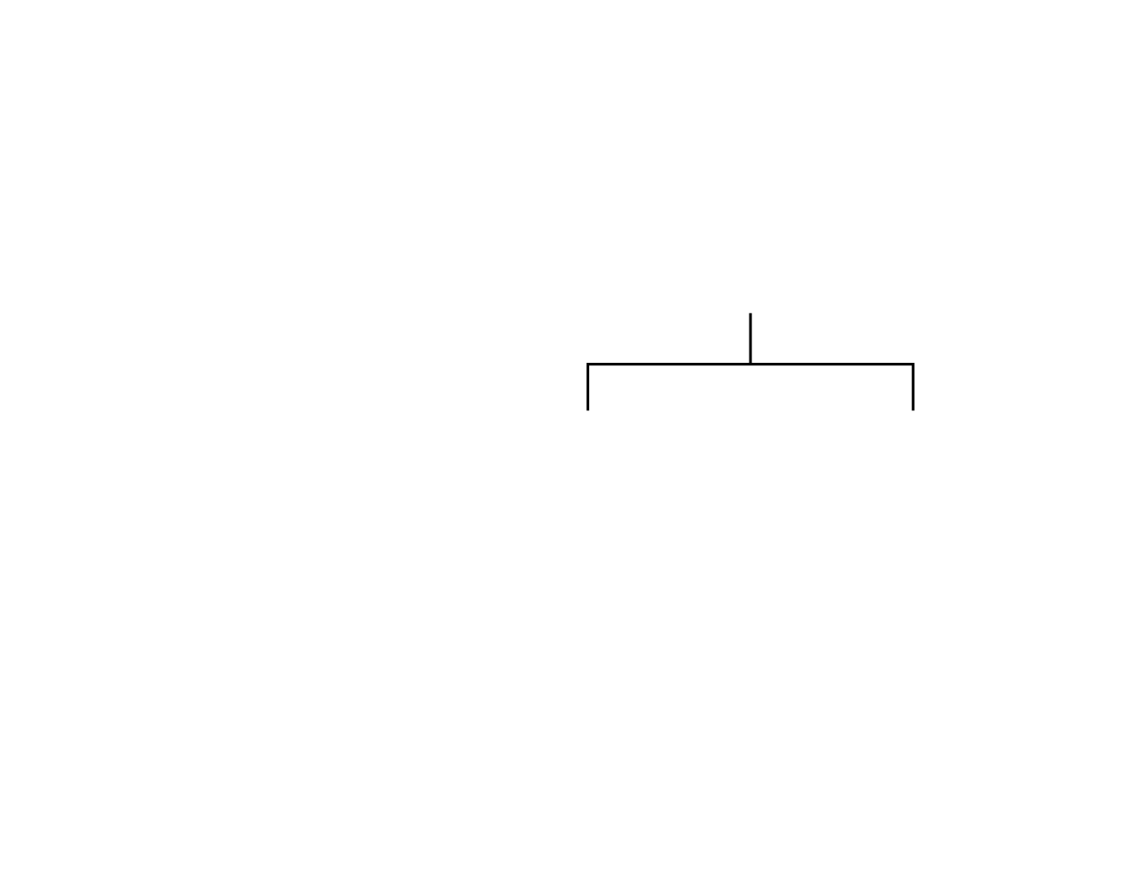
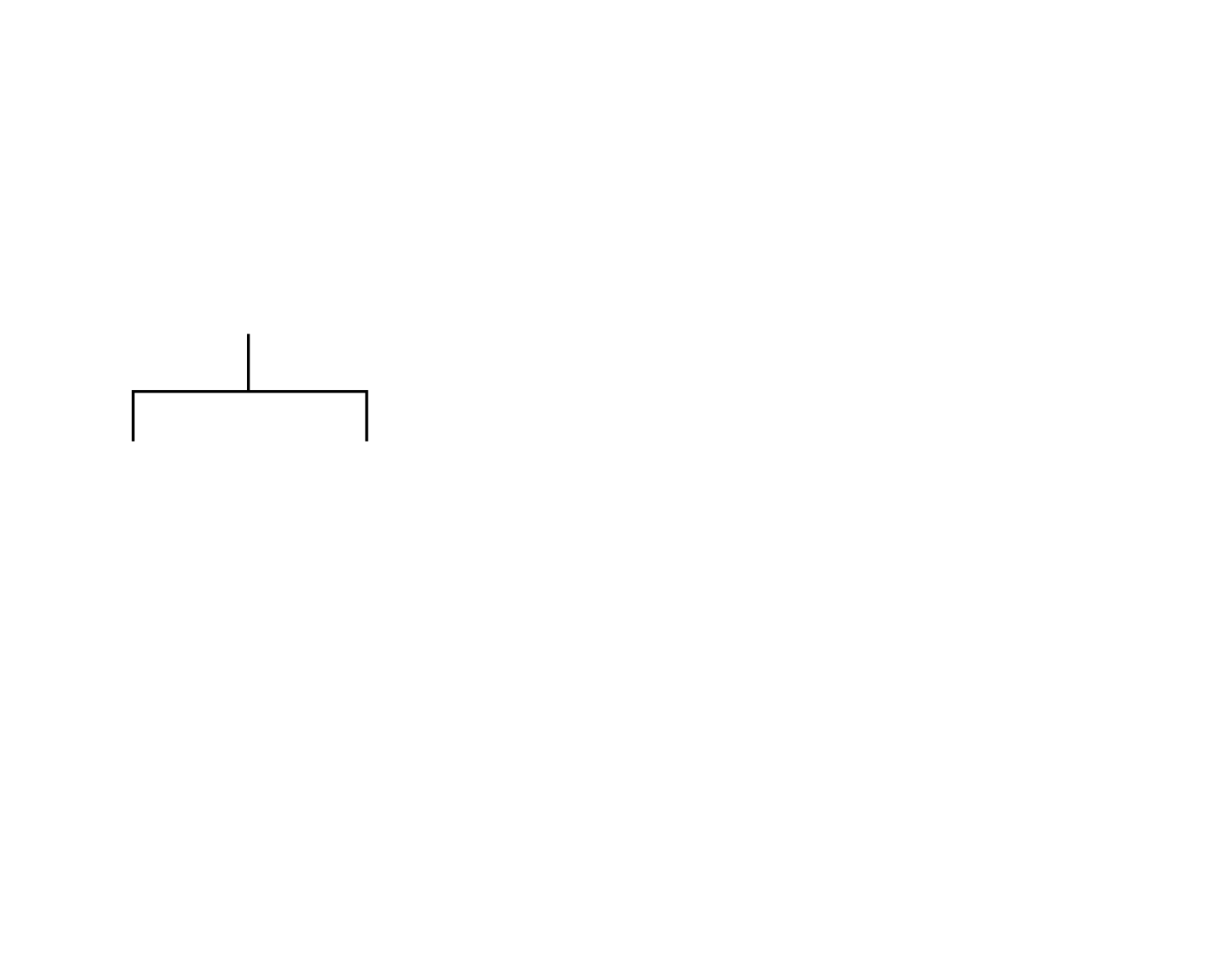
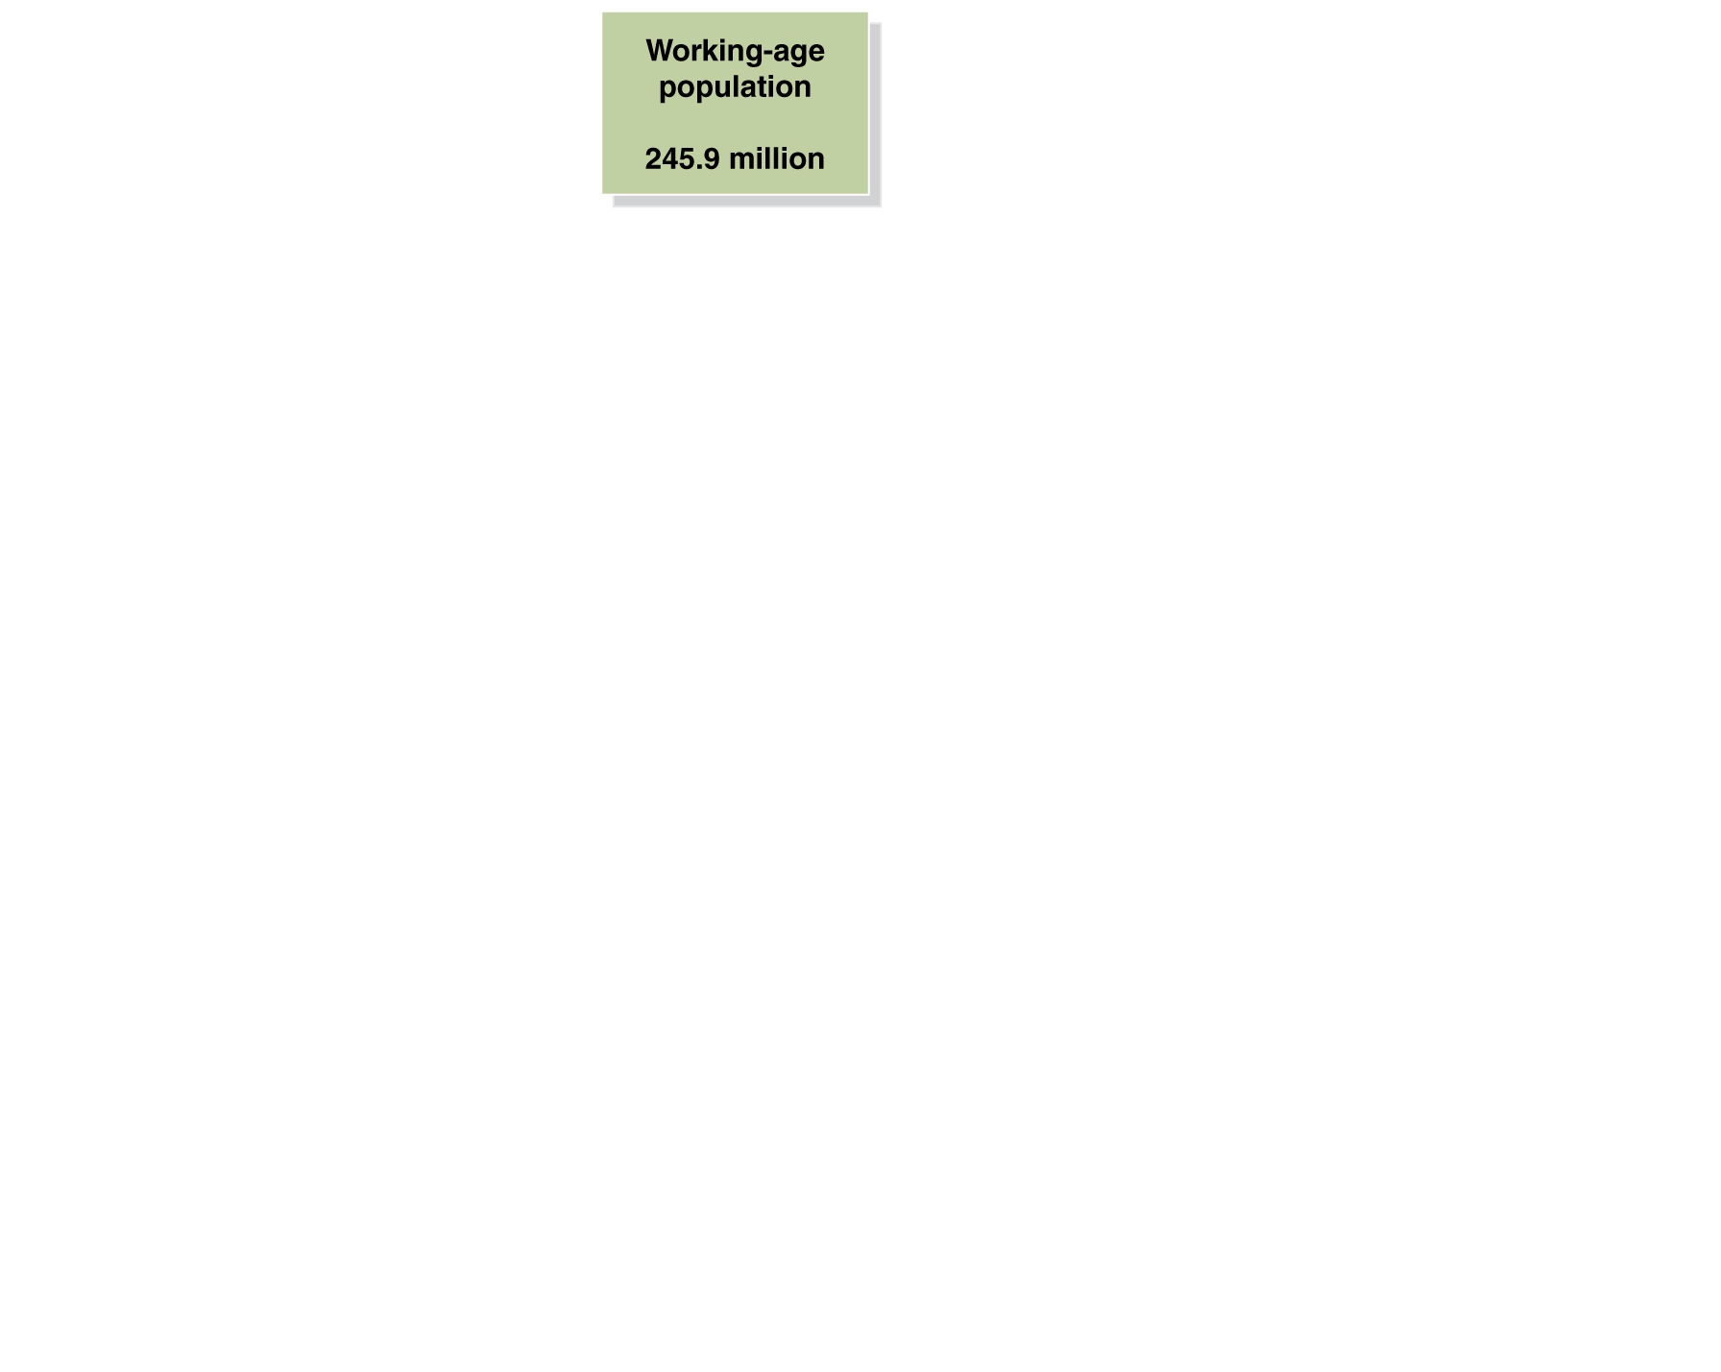

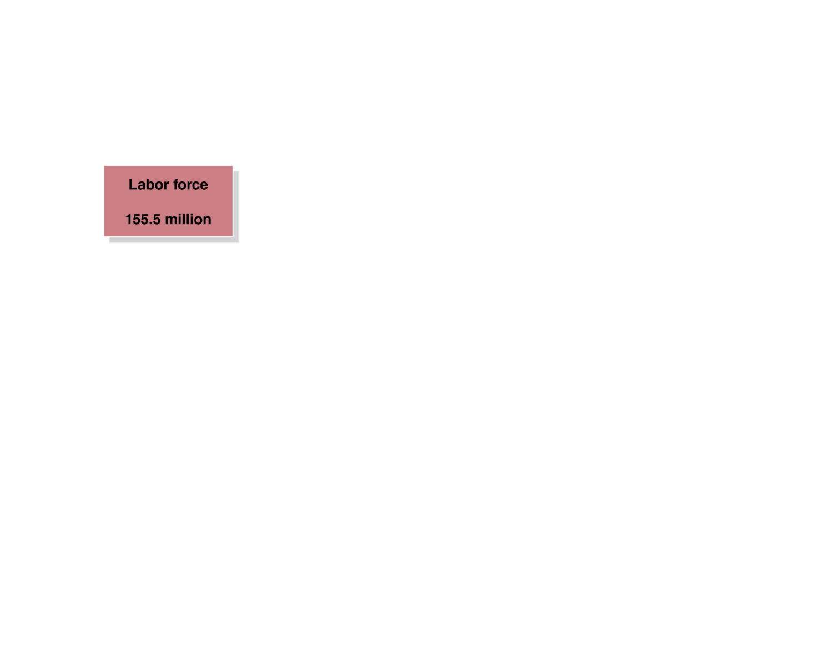
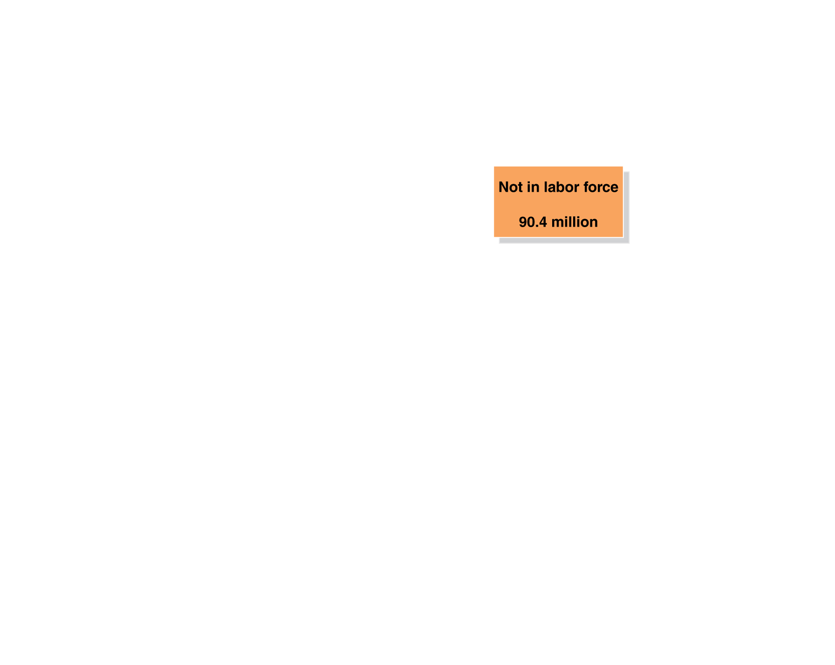
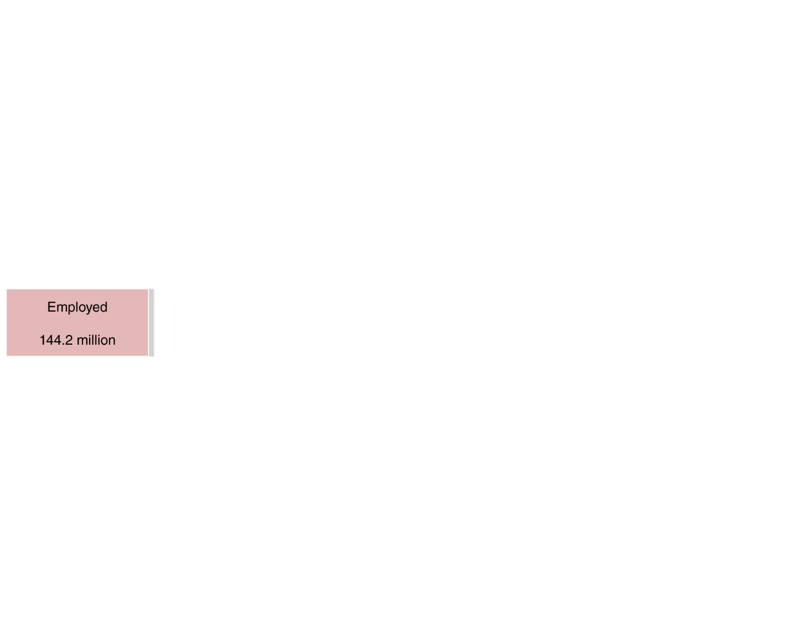
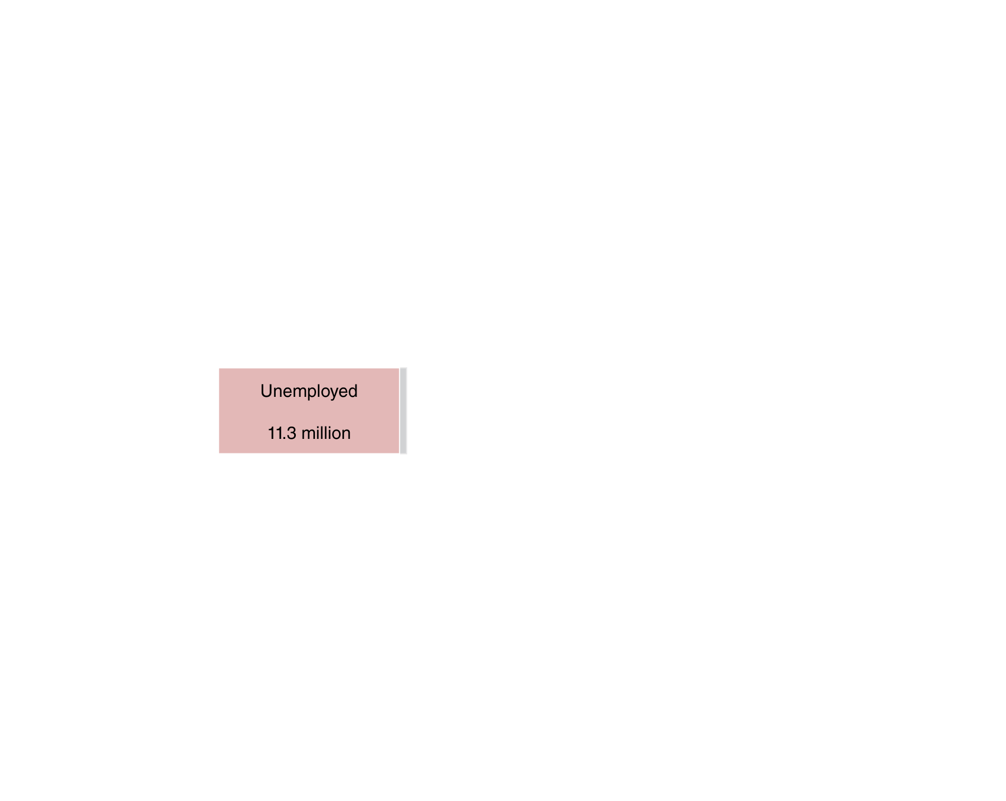
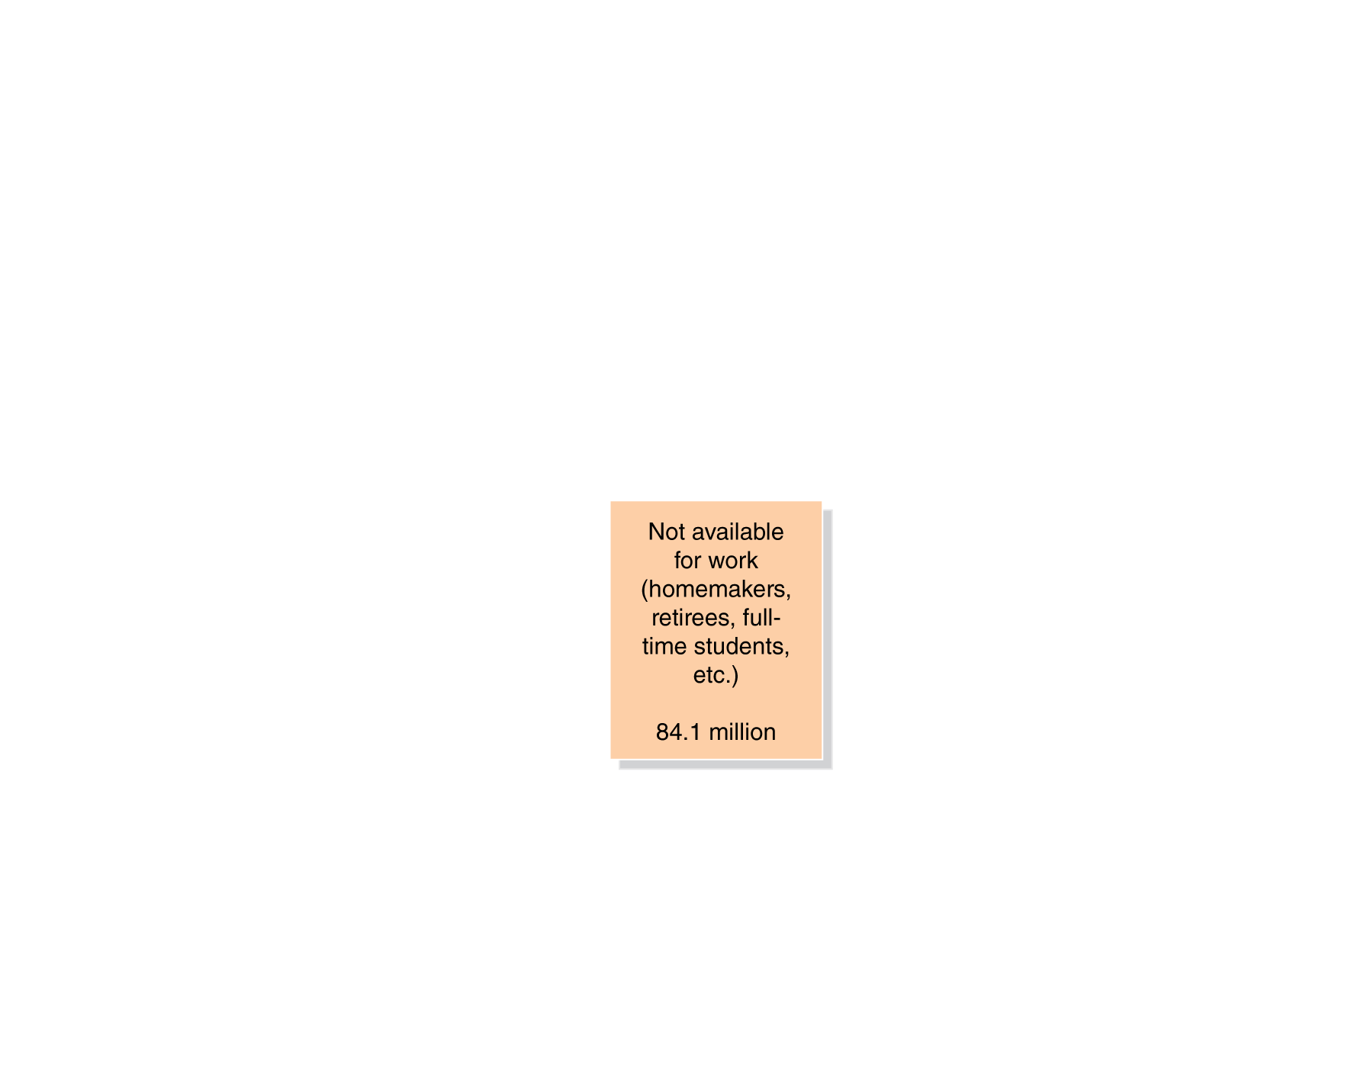

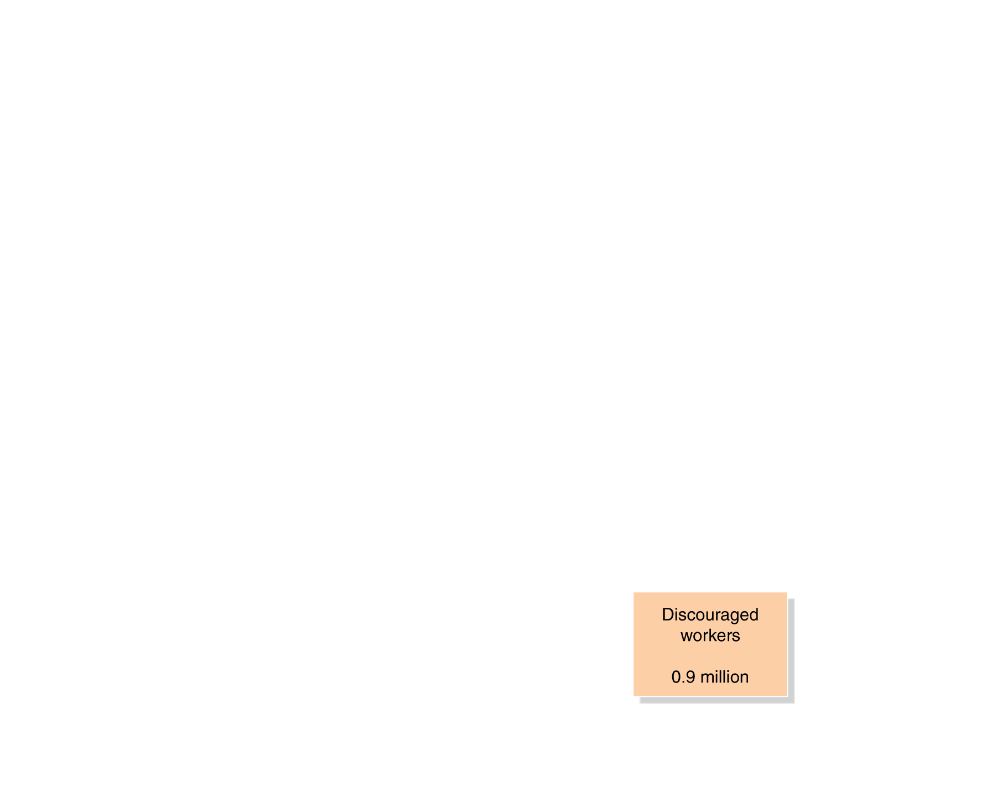

August 2013 civilian working-age population
Discouraged workers: People who are available for work, but have not looked for a job during the previous four weeks because they believe no jobs are available for them.
Figure 9.1
The employment status of the civilian working-age population, August 2013
Notes:
In August 2013, the working-age population of the United States was 245.9 million.
The working-age population is divided into those in the labor force (155.5 million)
and those not in the labor force (90.4 million). The labor force is divided into the
employed (144.2 million) and the unemployed (11.3 million). Those not in the labor
force are divided into those not available for work (84.1 million) and those available
for work but not currently working (6.3 million). Finally, those available for work but
not in the labor force are divided into discouraged workers (0.9 million) and those
not currently looking for work for other reasons (5.4 million).
Source: U.S. Department of Labor, Bureau of Labor Statistics, The Employment
Situation—August 2013, September 6, 2013.

Slide 8
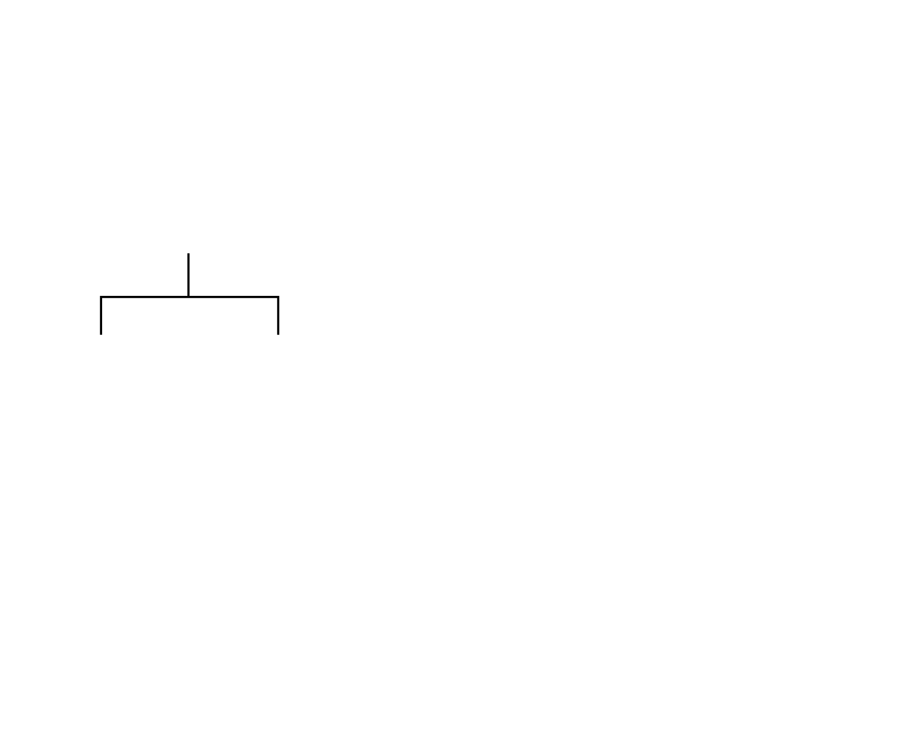


Unemployment rate
Based on the CPS estimates, we calculate several important macroeconomic indicators.
The most-watched is the unemployment rate:
This most-common measure of unemployment is known formally as BLS series U-3.
Figure 9.1
The employment status of the civilian working-age population, August 2013

Slide 9

Labor-force participation and employment-population
Also important are the labor-force participation rate (the percentage of the working-age population in the labor force)…
… and the employment-population ratio (the percentage of the working-age population that is employed):
Figure 9.1
The employment status of the civilian working-age population, August 2013

Slide 10
Problems with measuring the unemployment rate
The unemployment rate measured by the BLS is not a perfect measure of joblessness. Why?
It may understate unemployment:
Distinguishing between people who are unemployed and not in the labor force requires judgment (should we exclude “discouraged workers”?)
Only measures employment, not intensity of employment (full-time vs. part-time; some people are underemployed)
It may overstate unemployment:
People might claim falsely to be actively looking for work
May claim not to be working to evade taxes or keep criminal activity unnoticed

Slide 11

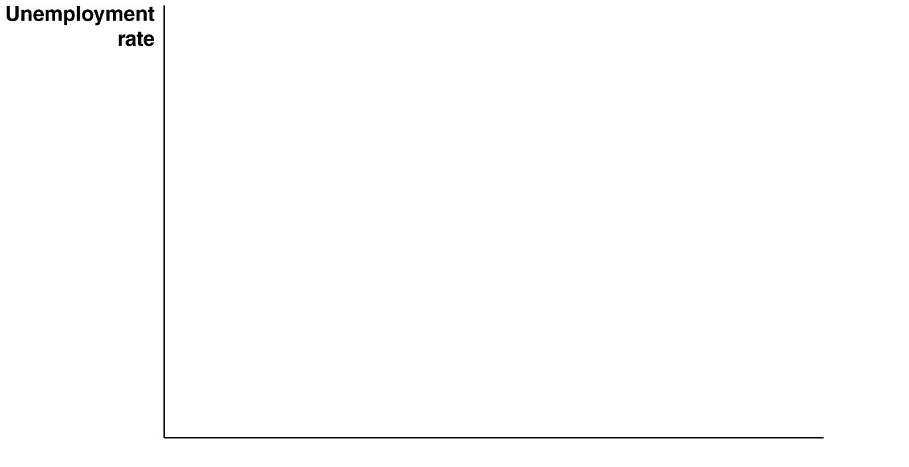
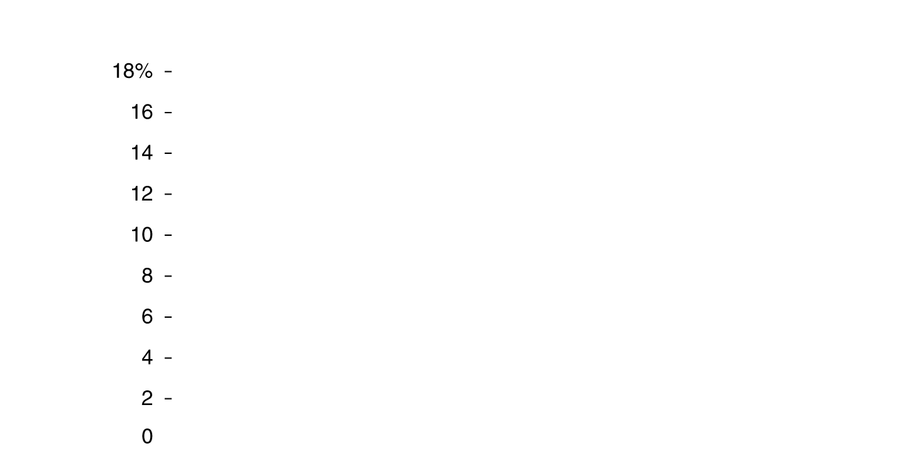
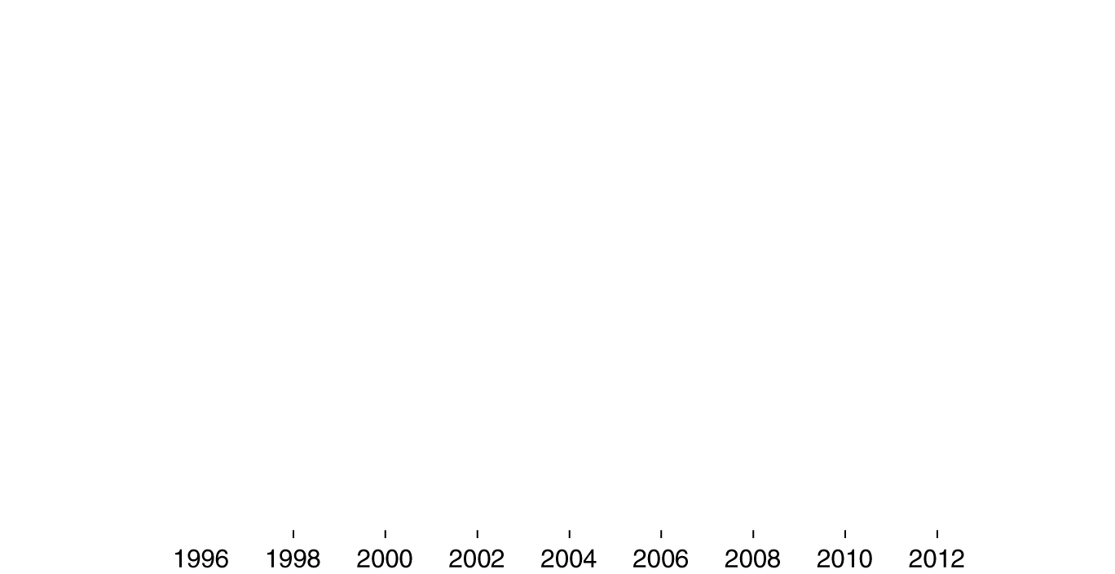
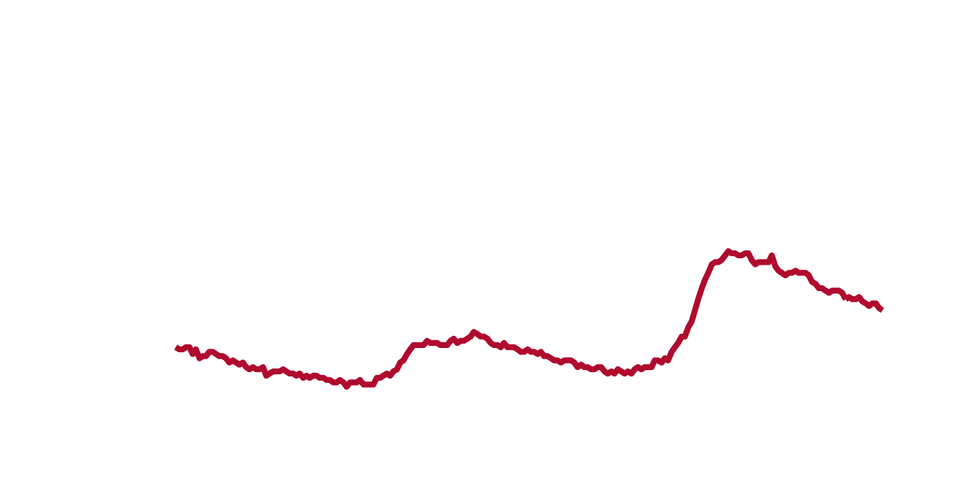
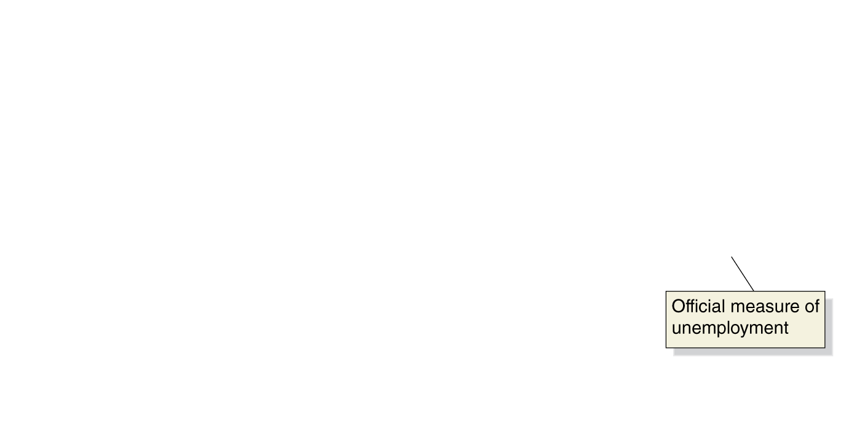
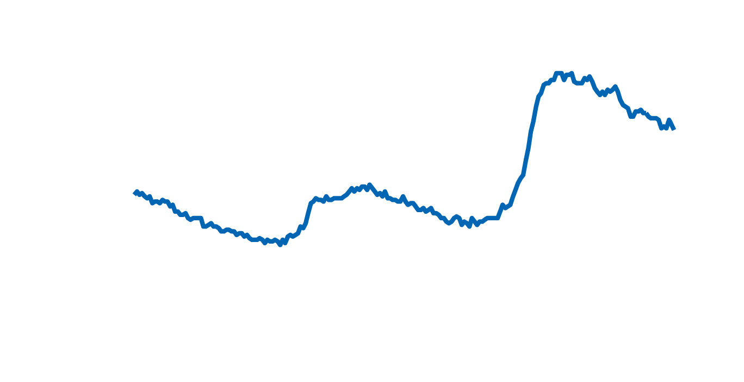
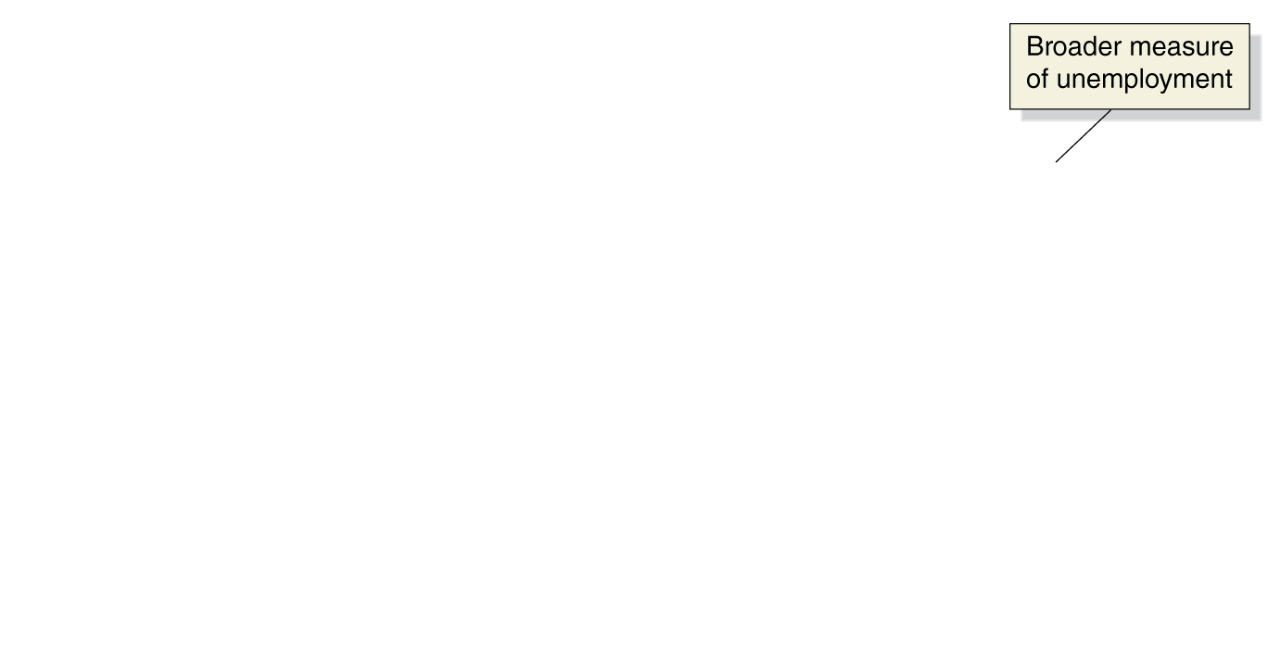
Alternative measures of unemployment: U-6
Some people suggest that we should include discouraged workers and underemployed workers in the unemployment statistics, to create a broader measure of unemployment.
The BLS measures this, calling it BLS series U-6.
Figure 9.2
The official unemployment rate and a broad measure of the unemployment rate, 1996-2013
Notes:
The red line shows the official measure of
the unemployment rate. The blue line shows
what the unemployment rate would be if
the BLS had counted as unemployed: (1) all
people who were available for work but not
actively looking for jobs, and (2) all people
who were in part-time jobs but wanted
full-time jobs. The difference between the
measures was particularly large during the
2007–2009 recession and the weak recovery
that followed. Shaded areas indicate months
of recession.
Note: The official measure is BLS series U-3,
and the broader measure is BLS series U-6.
Source: U.S. Bureau of Labor Statistics.

Slide 12
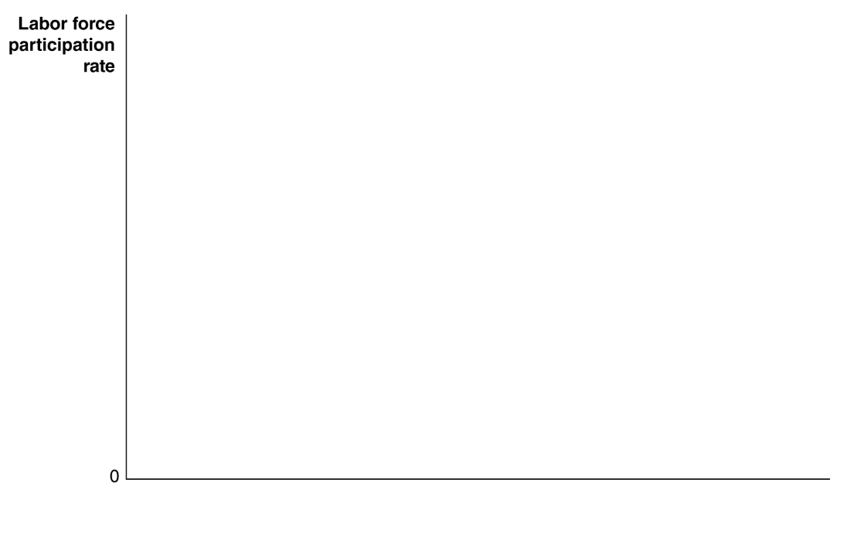

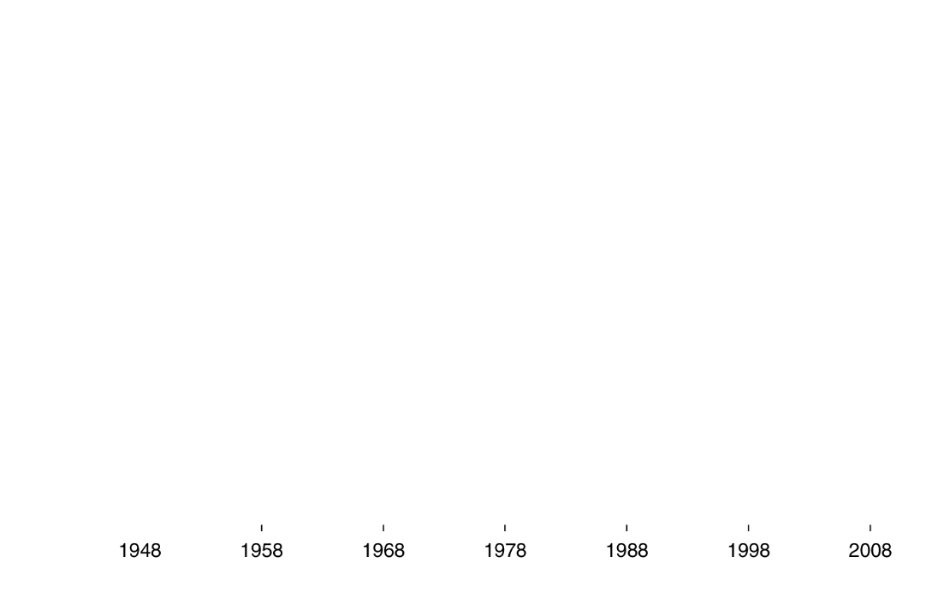
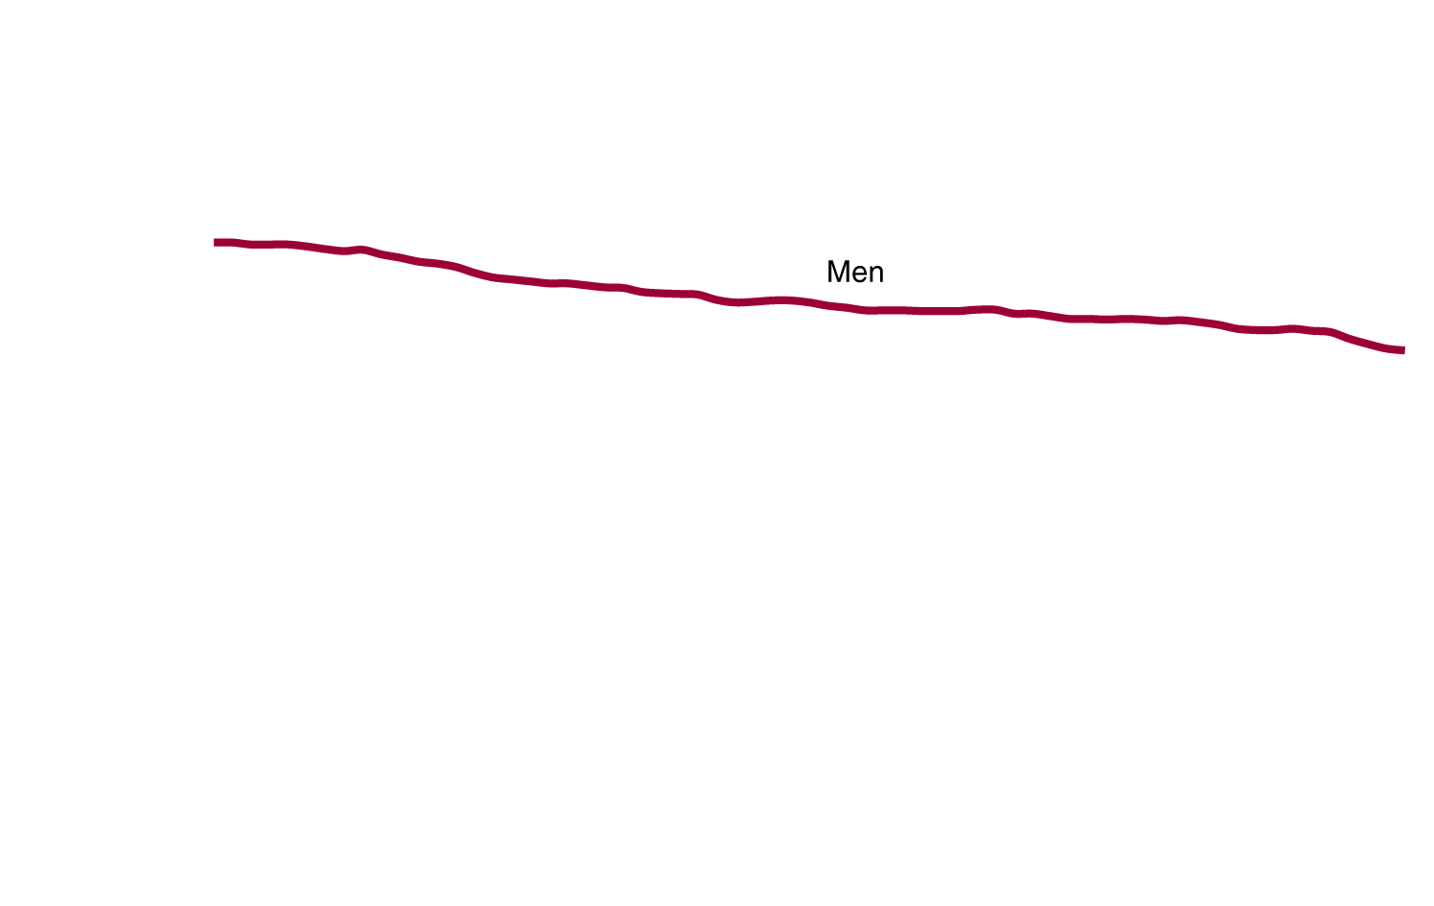
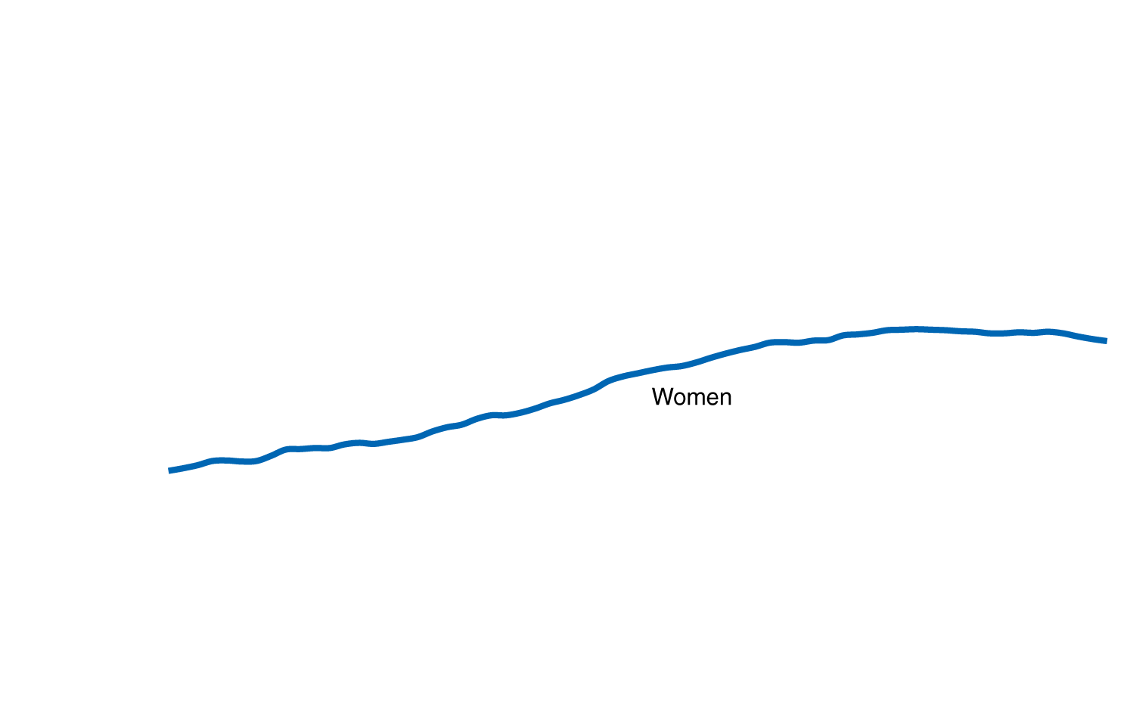
Trends in labor force participation
The labor force participation rate of adult men has declined gradually since 1948…
… but it has increased significantly for adult women, making the overall rate higher today than it was then.
Figure 9.3
Trends in the labor force: participation rates of adult men and women since 1948
Notes:
The labor force participation rate of adult
men has declined gradually since 1948, but
the labor force participation rate of adult
women has increased significantly, making
the overall labor force participation rate
higher today than it was in 1948.
Source: U.S. Bureau of Labor Statistics.

Slide 13
Is falling labor force participation bad?
Politicians often like to point to a “falling labor-force participation rate” as a strongly negative sign for the economy.
Is this necessarily true?
The two major reasons why the LFPR for men has fallen over the last several decades are:
Men have been going to school for longer and retiring earlier than before (why?)
Increases in Social Security Disability Insurance availability have allowed people with disabilities to stop work
Whether these are good or bad is a value judgment.

Slide 14
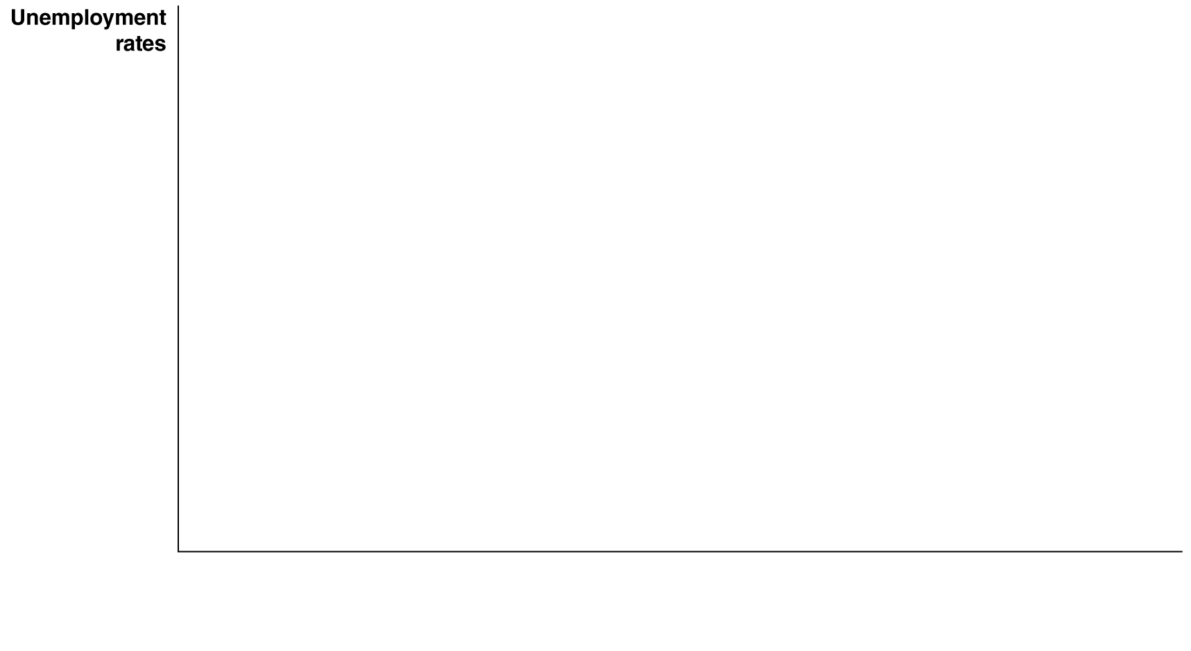





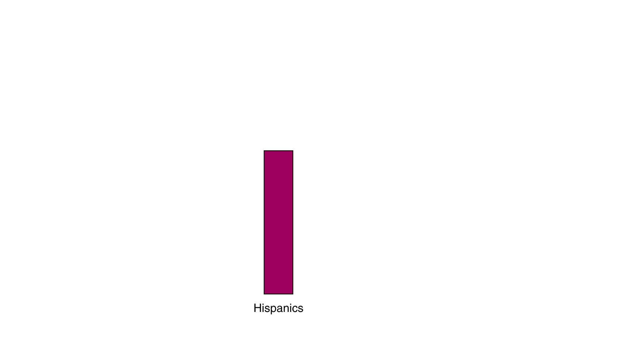
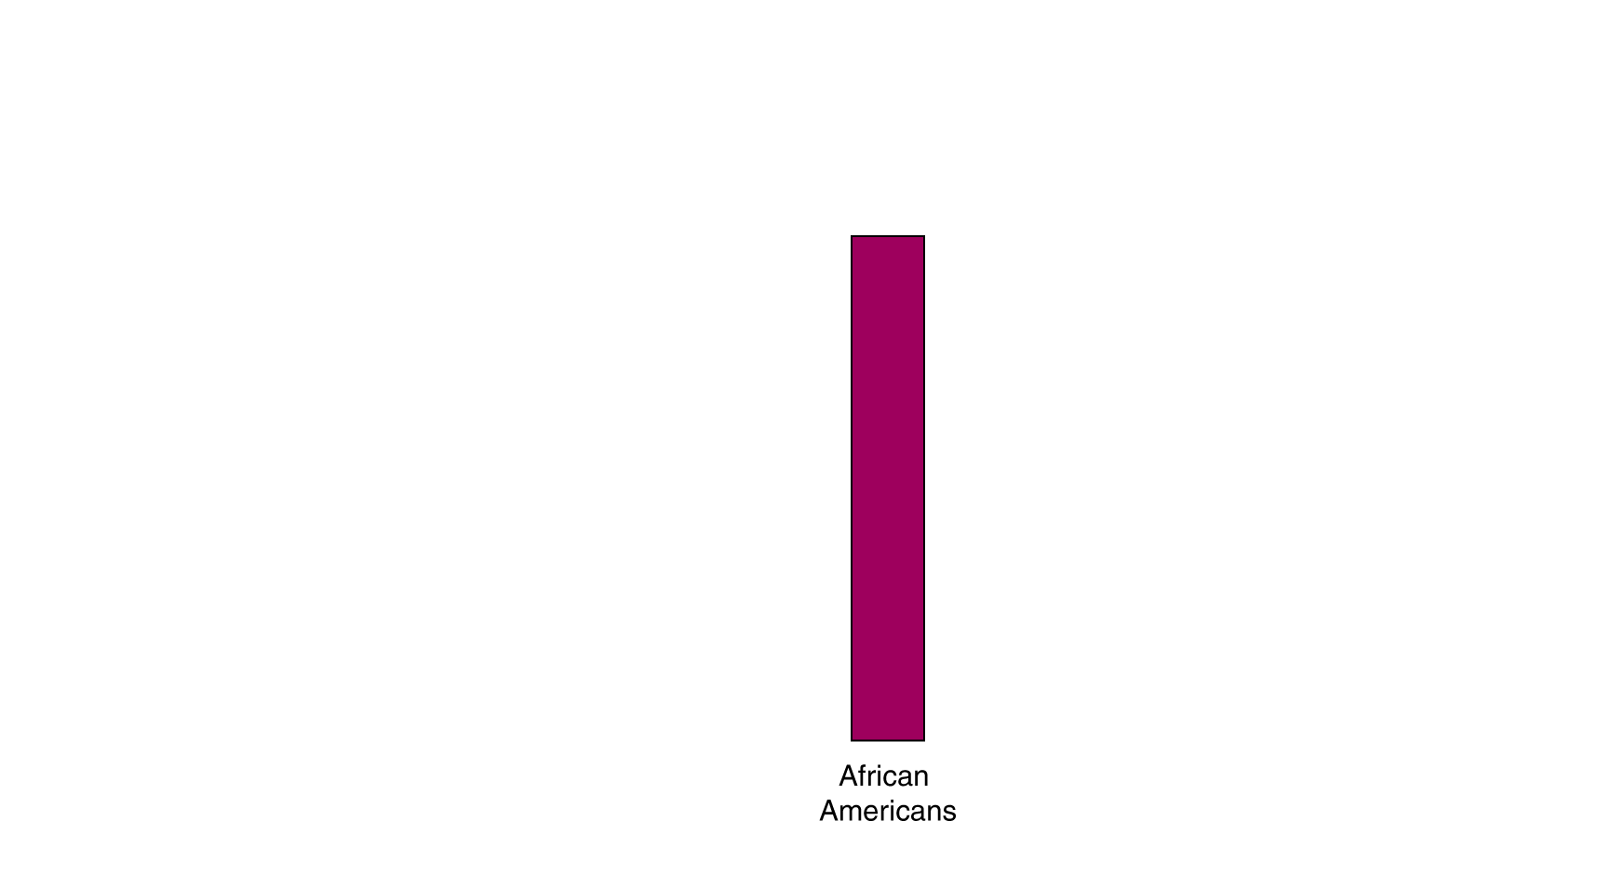
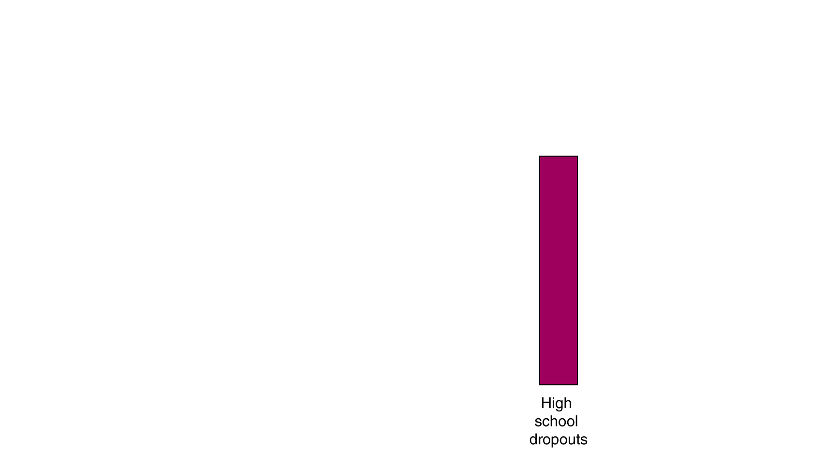


Unemployment rates for different groups
Unemployment rates vary by ethnic group…
… and by education level.
These two observations are statistically related.
Figure 9.4
Unemployment rates in the United States, August 2013
Notes:
The unemployment rate of African Americans is the highest of the four ethnic
groups shown, while the unemployment rate of Asians is the lowest. High school
dropouts have an unemployment rate that is triple the unemployment rate for
college
graduates.
Notes: The unemployment rates for ethnic groups apply to people 16 years and older;
the unemployment rates by educational attainment apply to people 25 years and older.
People identified as Hispanic may be of any race.
Source: U.S. Department of Labor, Bureau of Labor Statistics, The Employment
Situation—August 2013, September 6, 2013.

Slide 15

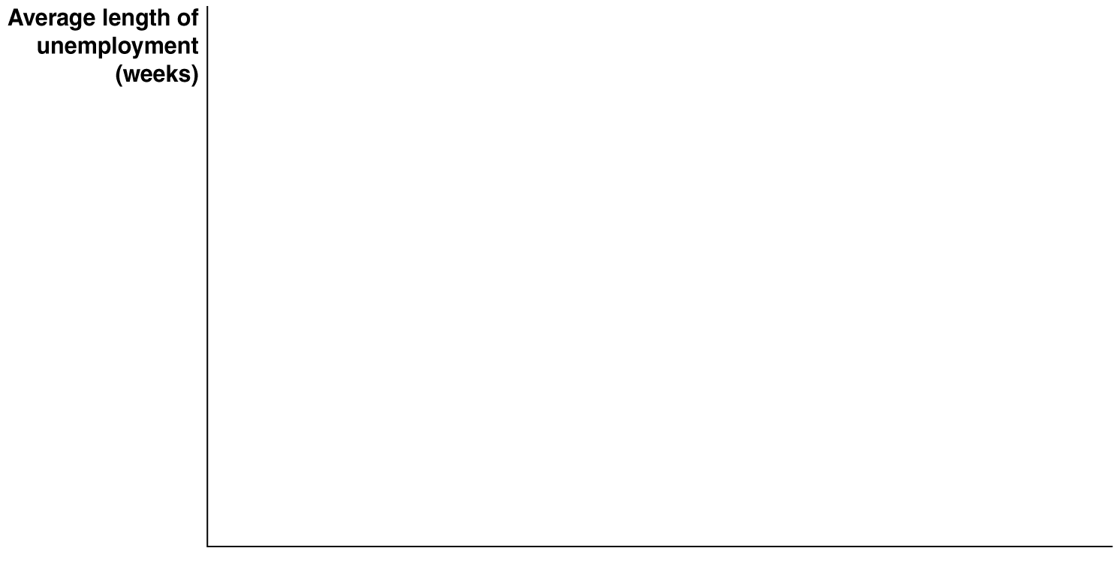

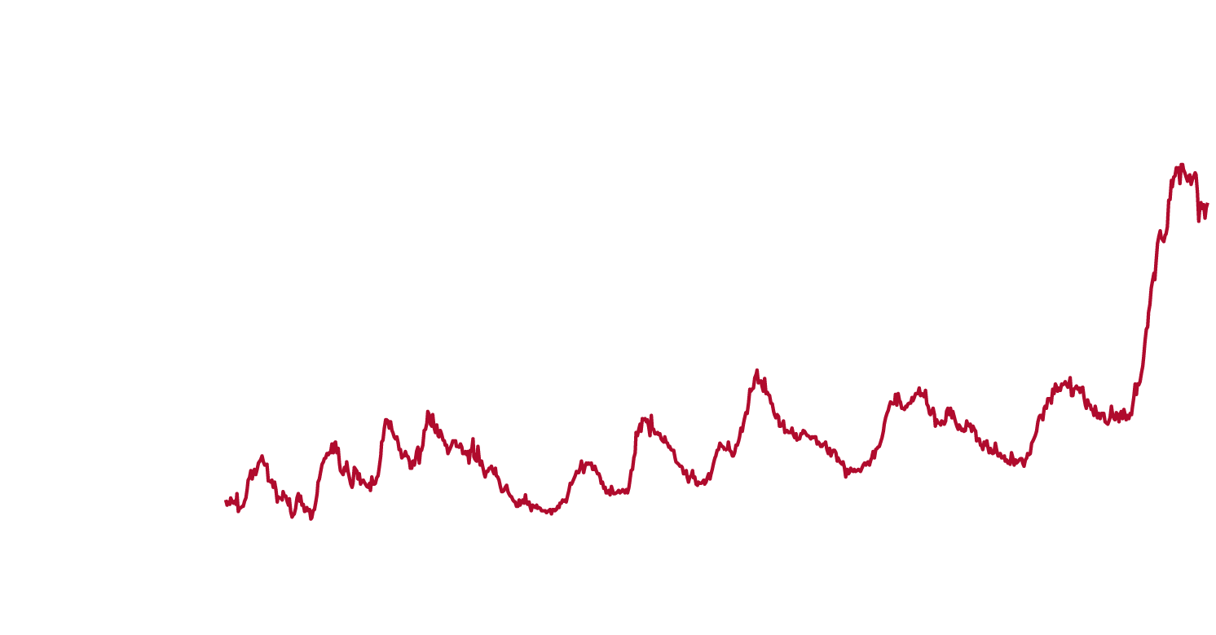
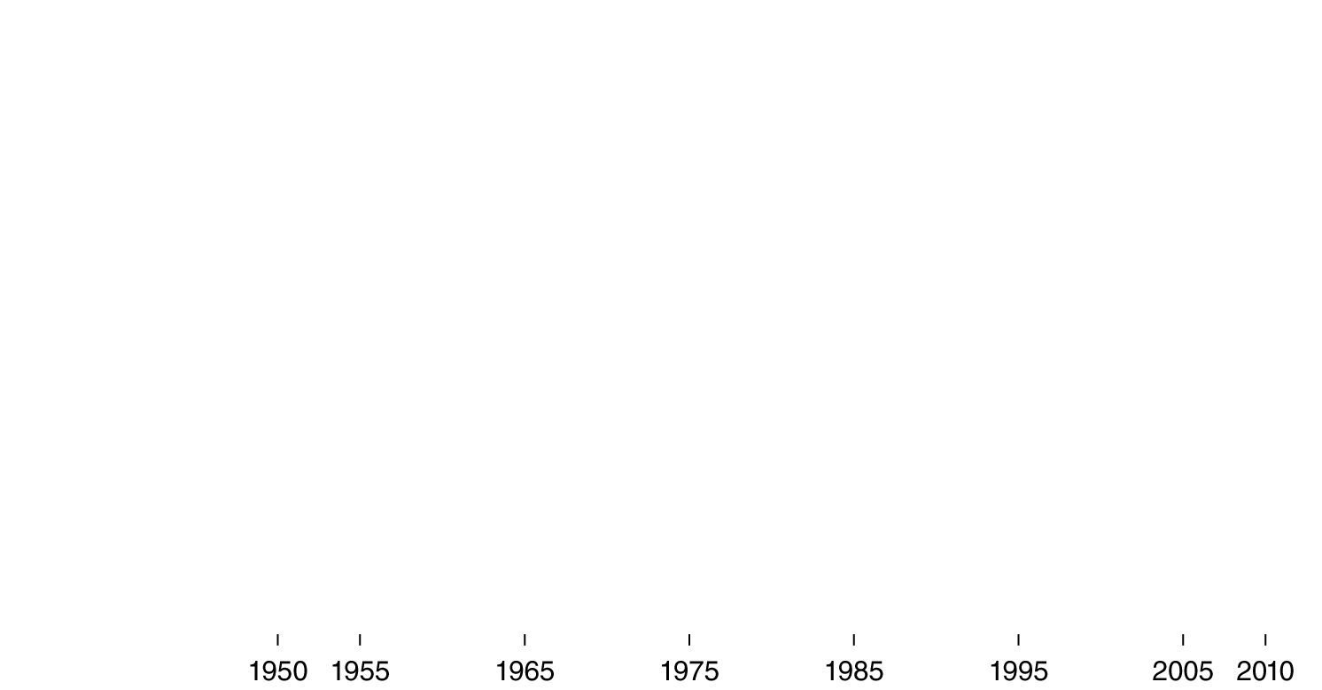
How long are people typically unemployed?
Long periods of unemployment are bad for workers, as their skills decay and they risk becoming discouraged and depressed.
During the Great Depression of the 1930s, some people were unemployed for years at a time.
Since World War II, average lengths of unemployment have been relatively low; but that changed dramatically with the 2007-2009 recession.

Slide 16

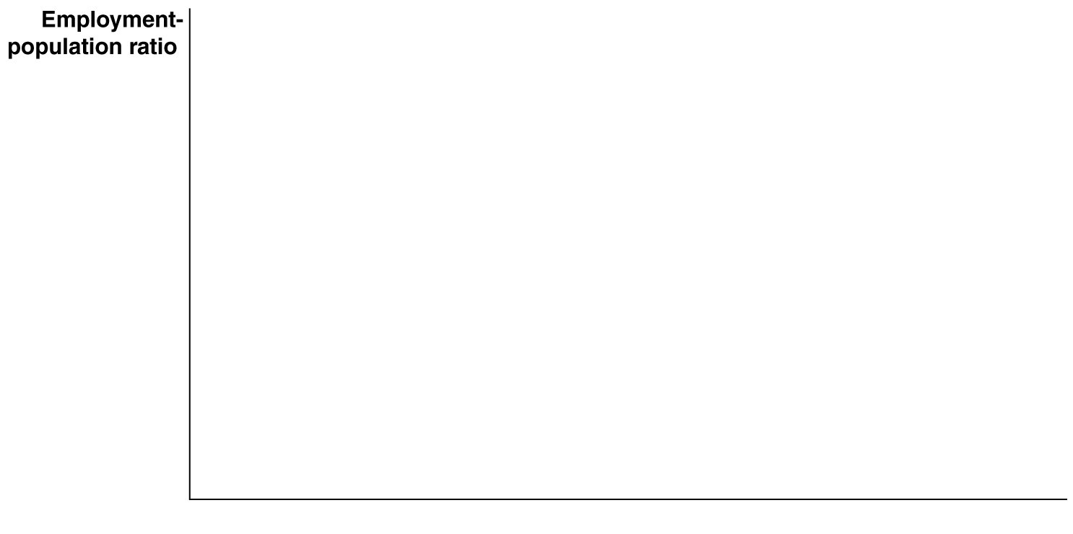
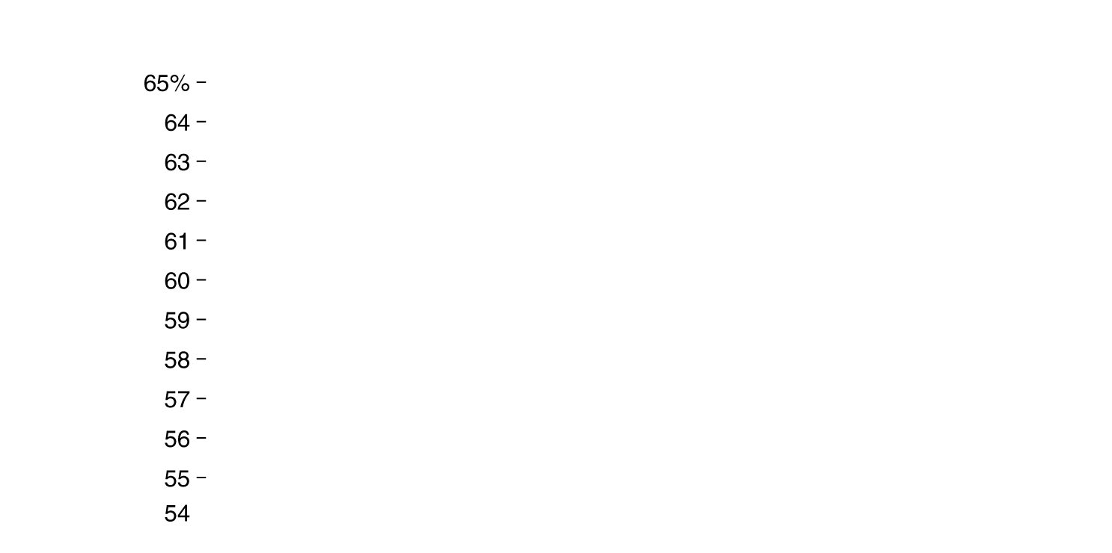
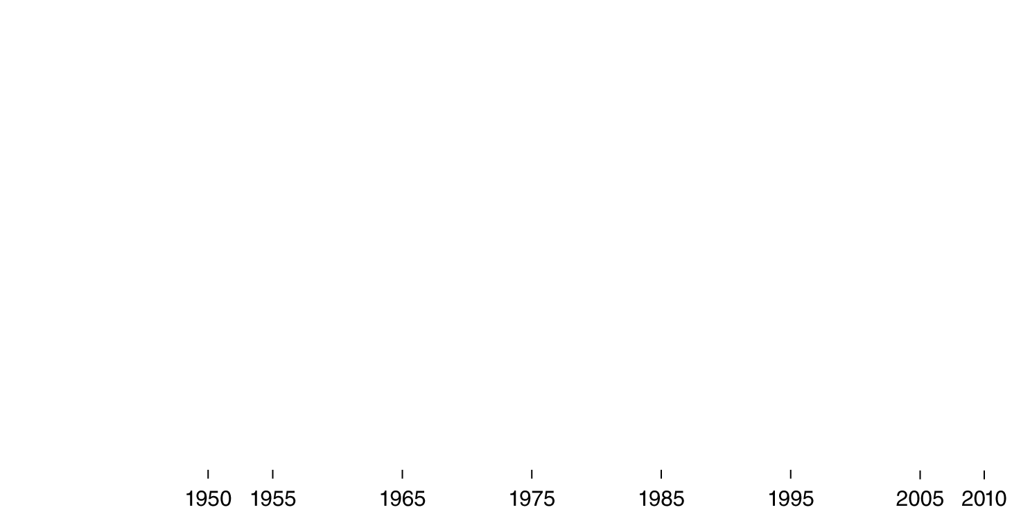
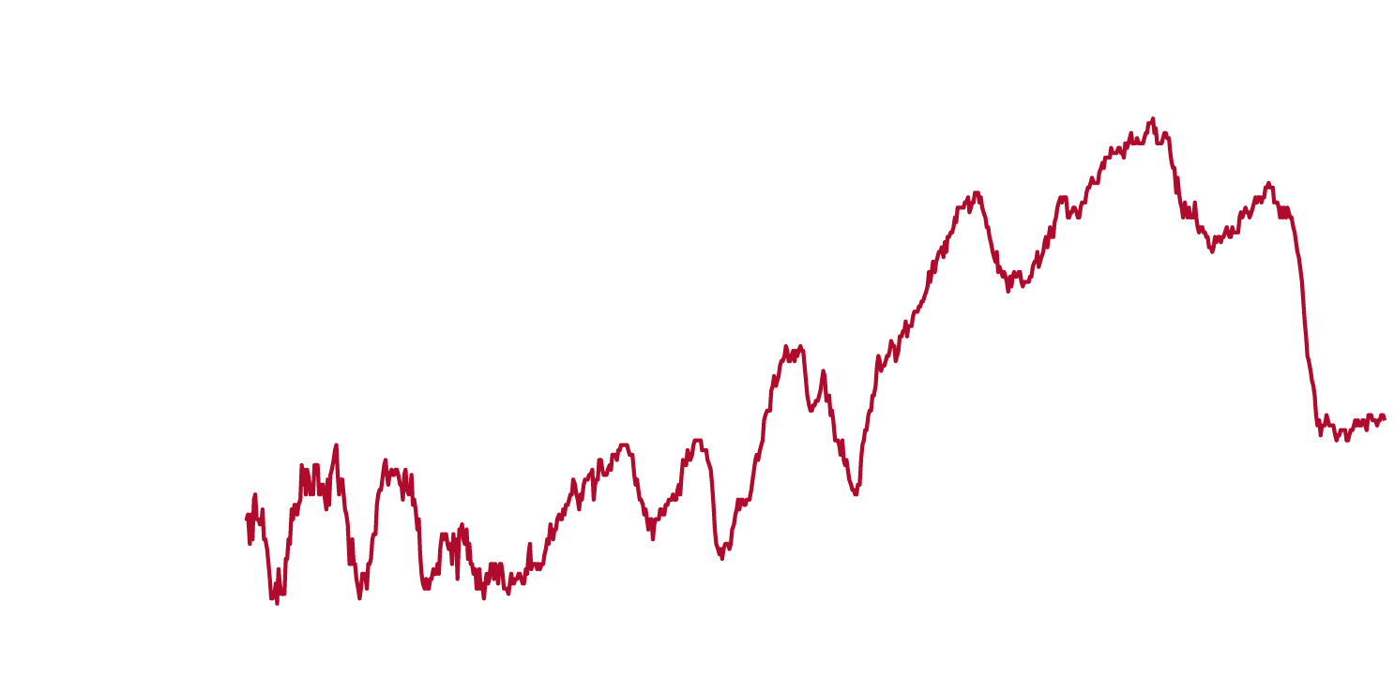
The employment situation following the 2007-2009 recession
The fall of the employment–population ratio may give an even better indication of how weak the U.S. labor market was during and after the 2007–2009 recession.
Explaining these changes is a top priority for labor economists.

Slide 17
The establishment survey
In addition to the household survey, the BLS also uses the establishment survey, (a.k.a. the payroll survey).
This survey samples ~300,000 establishments, or places of employment, about their employees. Disadvantages include:
Self-employed people not surveyed (not on a company payroll)
Newly-opened firms often omitted
Information on employment only, not unemployment
Numbers fluctuate depending on establishments included, often requiring large revisions
However, a big advantage is that the data are determined by real payrolls, not self-reporting like the household survey.

Slide 18
Comparing the household and establishment surveys
The table below gives the data from the July and August 2013 household and establishment surveys:
 | Household Survey |  |  |  | Establishment Survey
 | July | August | Change |  | July | August | Change
Employed | 144,285,000 | 144,170,000 | –115,000 |  | 135,964,000 | 136,133,000 | 169,000
Unemployed | 11,514,000 | 11,316,000 | –198,000
Labor force | 155,798,000 | 155,486,000 | –312,000
Unemployment rate | 7.4% | 7.3% | –0.1%
Table 9.1
Household and establishment survey data for July and August 2013
Even if all surveys are truthfully and accurately answered, we do not expect the numbers to be identical between the two surveys:
Different groups are measured
All surveys have measurement errors
But we get a more complete picture by considering both surveys.

Slide 19
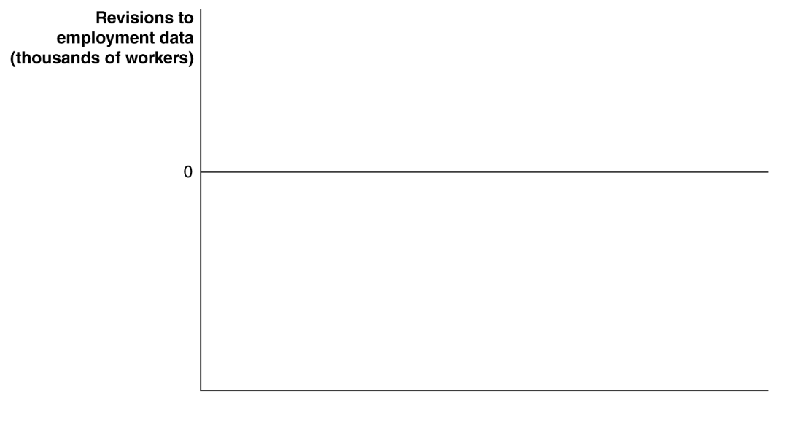







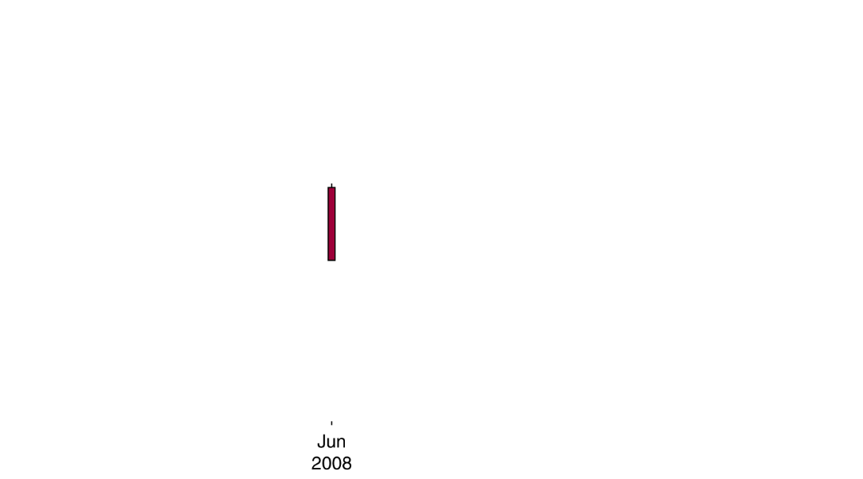





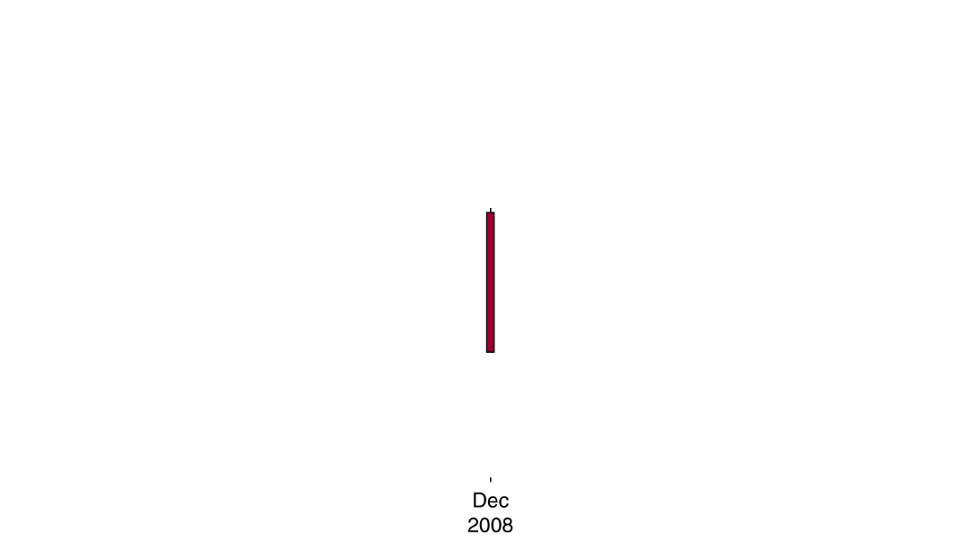
























Revisions to employment numbers
Over time, the BLS adjusts its estimates of employment and unemployment for previous months. Revisions sometimes take place years later.
The large negative revisions were because the BLS underestimated the severity of the 2007-2009 recession.
Figure 9.5
Revisions to employment changes, as reported in the establishment survey
Notes:
Over time, the BLS revises its preliminary
estimates of changes in employment. During
the 2007–2009 recession, many more
jobs were lost than the preliminary estimates
showed. The green bars show months
for which the BLS revised its preliminary
estimates to show fewer jobs were lost (or
more jobs were created), and the red bars
show months for which the BLS revised its
preliminary estimates to show more jobs
were lost (or fewer jobs were created).
Source: U.S. Bureau of Labor Statistics.

Slide 20
Job creation and destruction
 | Number of Jobs
Establishments Creating Jobs
Existing establishments | 5,752,000
New establishments | 1,299,000
Establishments Eliminating Jobs
Existing establishments | 5,180,000
Closing establishments | 1,203,000
Jobs are continually being created and destroyed in the U.S. economy. In 2012, about 27.8 million jobs were created, while about 25.5 million jobs were destroyed.
This is a natural and normal process for the economy.
The table shows jobs created and destroyed over a three-month period from September to December 2012.
Table 9.2
Establishments creating and eliminating jobs, September-December 2012

Slide 21
Types of Unemployment
9.2
Identify the three types of unemployment.

Slide 22
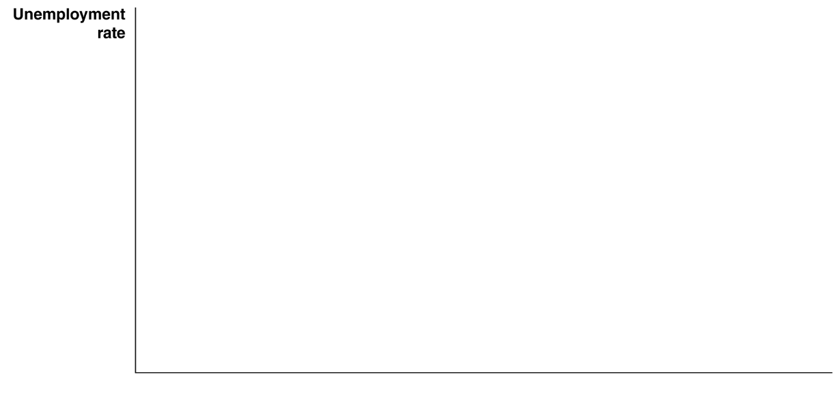

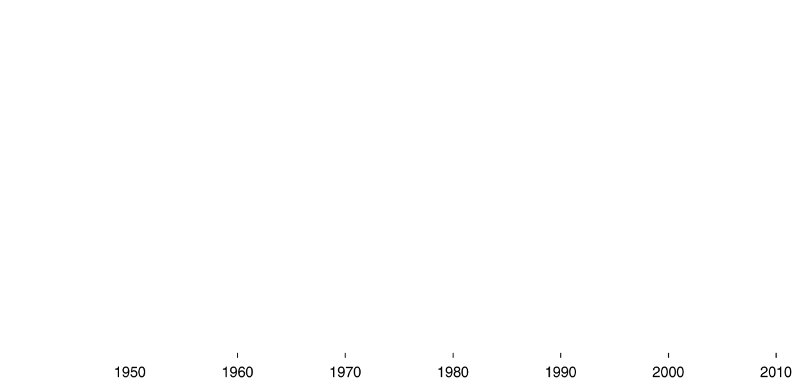

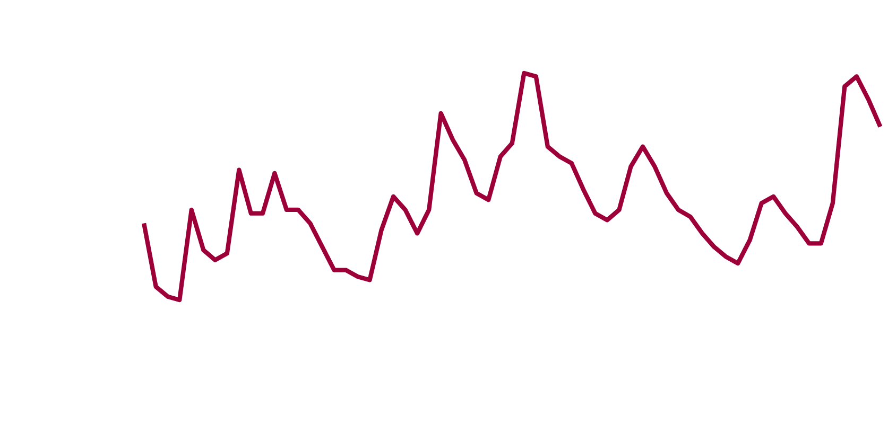
U.S. annual unemployment rate over time
Unemployment rates rise when the economy is faltering, and fall when the economy is doing well. But they never fall to zero.
To understand why, we will examine the types of unemployment.
Figure 9.6
The annual unemployment rate in the United States, 1950-2012
Notes:
The unemployment rate rises during
recessions and falls during expansions.
Shaded areas indicate recessions.
Source: U.S. Bureau of Labor Statistics.

Slide 23
Three types of unemployment
The three types of unemployment are:
Frictional unemployment
Structural unemployment
Cyclical unemployment
We will examine each in turn over the coming slides.

Slide 24
Frictional unemployment
Frictional unemployment: Short-term unemployment that arises from the process of matching workers with jobs.
Frictional unemployment occurs mostly because of job search: entering or re-entering the labor force, or being between jobs.
It also occurs because of seasonal unemployment: some jobs fluctuate in availability due to seasonal demand, like ski-instructor or farm-work.
To control for this, the BLS releases raw and seasonally-adjusted employment figures.
Some frictional unemployment actually increases economic efficiency by allowing for better job matches.

Slide 25
Structural unemployment
Structural unemployment: Unemployment that arises from a persistent mismatch between the skills and attributes of workers and the requirements of jobs.
Structural unemployment is associated with longer unemployment spells.
Workers who are structurally unemployed may require retraining in order to obtain “modern” jobs.

Slide 26
Cyclical unemployment
Cyclical unemployment: Unemployment causes by a business cycle recession.
In normal recoveries after a recession, unemployment due to cyclical factors will fall.
When all unemployment is due to frictional and structural factors, we say that the economy is at full employment. This means there will always be some unemployment in the economy.
Economists call this the natural rate of unemployment: The normal rate of unemployment, consisting of frictional unemployment and structural unemployment.
The general consensus of economists is that the U.S. natural rate of unemployment is somewhere between 5 and 6 percent.

Slide 27
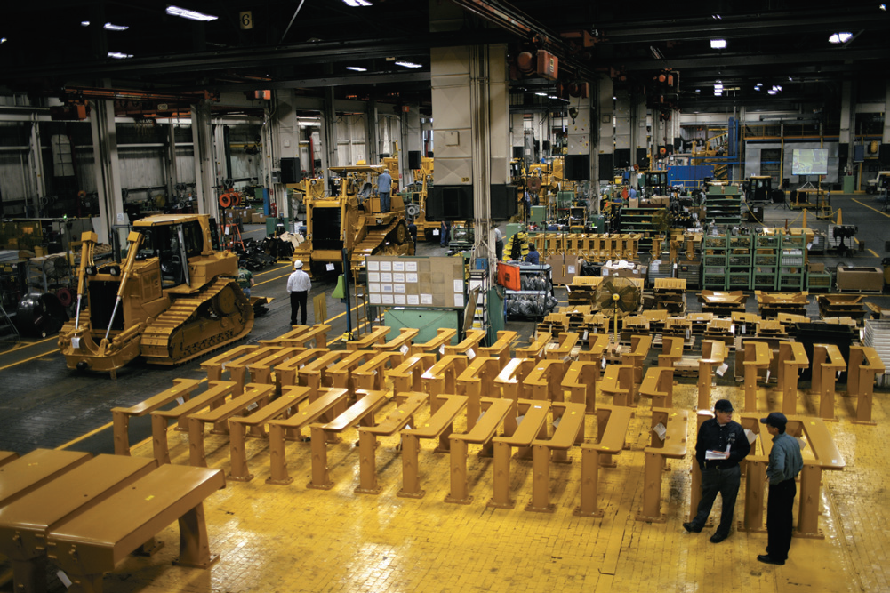
How should we categorize unemployment at Caterpillar?
In 2013, Caterpillar announced layoffs at its South Milwaukee plant.
Did this increase frictional, structural, or cyclical unemployment?
This is generally a hard question to answer; we need to look closely at this specific plant:
The South Milwaukee plant manufactured mining equipment.
Prices for mining products were in decline, decreasing demand for Caterpillar’s mining machinery. But sales of other equipment remained strong.
The laid-off workers were likely specialists at making mining equipment; so they are probably structurally unemployed.

Slide 28
Explaining Unemployment
9.3
Explain what factors determine the unemployment rate.

Slide 29
Government policies and the unemployment rate
Governments often attempt to directly influence unemployment.
Example: The federal government’s Trade Adjustment Assistance program offers training to workers whose firms laid them off as a result of competition from foreign firms. This would reduce structural unemployment.
Other policies try to reduce frictional unemployment, for example by subsidizing new hires.
However some other government policies probably increase unemployment, like
Unemployment insurance, and
Minimum wage laws
We will examine the effects of each of these on unemployment.

Slide 30
Unemployment insurance
Suppose you have just lost your job. You want to find another, and have two main options:
Take a new low-paying job immediately, or
Search for a better job
If unemployment insurance payments are available to you, you will probably be more likely to choose the second option.
In the U.S., unemployment insurance payments are typically not very generous, compared with other high-income countries; and there are relatively short time-limits.
Many economists believe that the more generous unemployment insurance benefits available in other high-income countries like Germany and France have contributed to higher unemployment rates in those countries.

Slide 31
Minimum wage laws
Minimum wage laws are designed to help low-income workers; but raising the wage that firms have to pay will likely result in them hiring fewer workers.
Year | Federal minimum wage | Inflation-adjusted minimum wage
1938 (first year of federal minimum wage) | $0.25 per hour | $4.15 per hour
2013 | $7.25 per hour | $7.25 per hour
Relatively few full-time adults earn minimum wage. The group most likely to receive minimum wage is teenagers.
How much unemployment does the minimum wage really cause? Economists are uncertain, but believe it to be relatively small.
Studies suggest a 10% increase in the minimum wage would reduce teenage employment by about 2%.
Notes:
Used inflation calculator at http://data.bls.gov/cgi-bin/cpicalc.pl?cost1=0.25&year1=1938&year2=2013

Slide 32
Labor unions
Labor unions are organizations of workers that bargain with employers for higher wages and better working conditions.
Unions are probably not a significant cause of unemployment in the United States. While they raise the wage, only about 9% of private-sector workers are unionized, limiting the effect that unions have on the wider economy.

Slide 33
Efficiency wages
Efficiency wage: An above-market wage that a firm pays to increase workers’ productivity.
Firms want to get the best performance they can out of their workers. Sometimes monitoring workers is difficult or costly; an alternative is to pay them a relatively high wage, making them motivated to perform well in order to keep their job.
These above-market wages are probably another reason why unemployment exists even when cyclical unemployment is zero.

Slide 34
Measuring Inflation
9.4
Define price level and inflation rate and understand how they are computed.

Slide 35
Price level and inflation rate
In the previous chapter we introduced the idea of the price level: a measure of the average prices of goods and services in the economy.
We refer to the percentage increase in the price level from one year to the next as the inflation rate.
Last chapter, we used the GDP deflator to measure changes in the price level. By measuring changes in the prices of different baskets of goods, we would come up with different measures.
Two commonly-used measures are:
The consumer price index (CPI)
The producer price index (PPI)
We will examine each in turn.

Slide 36

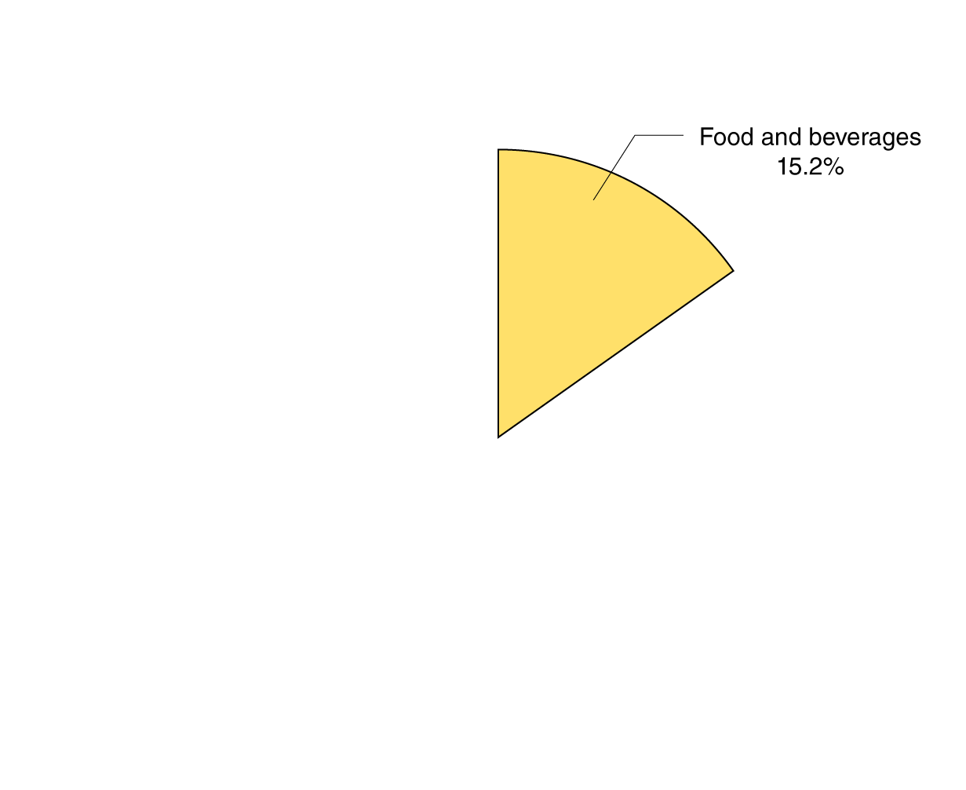

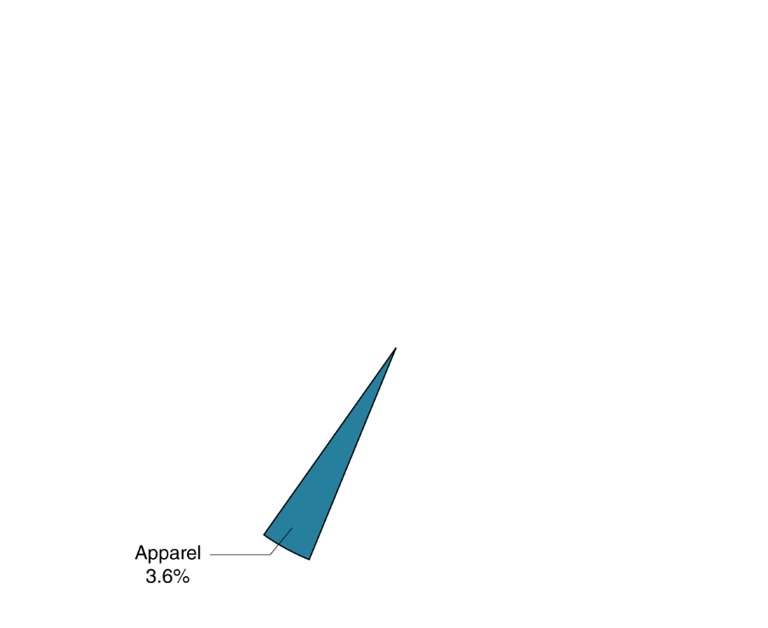
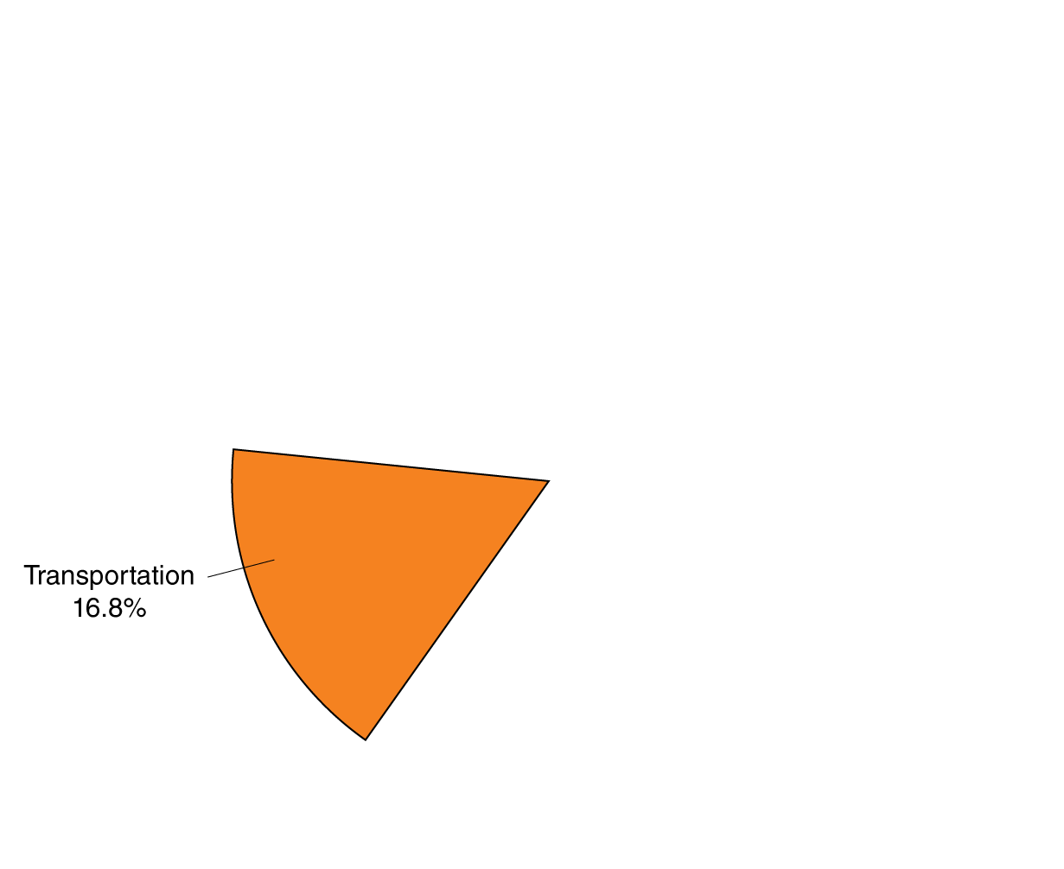
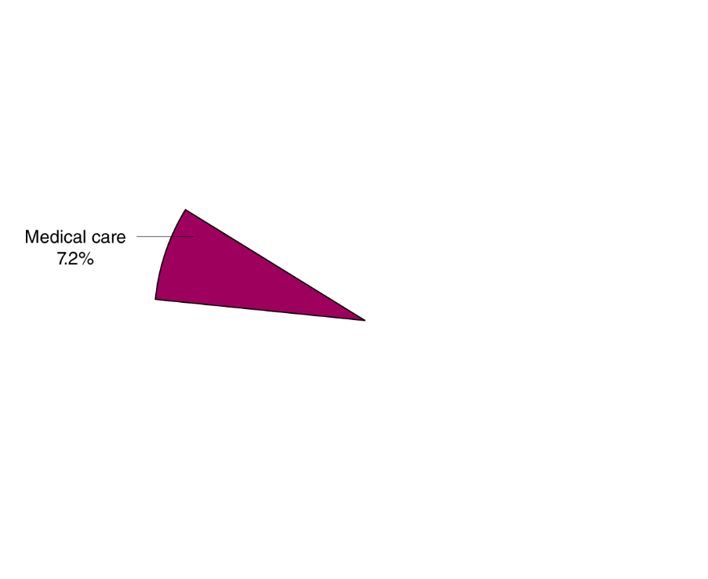
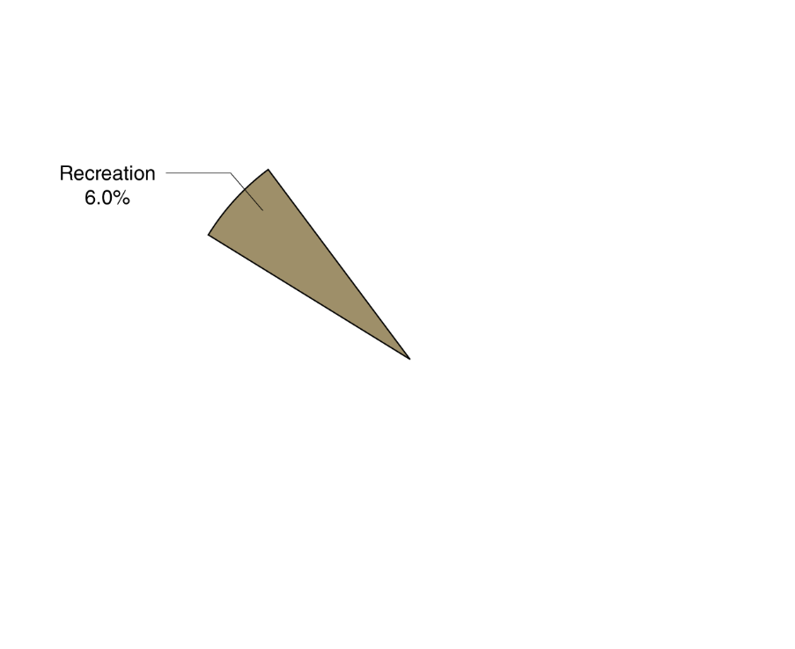
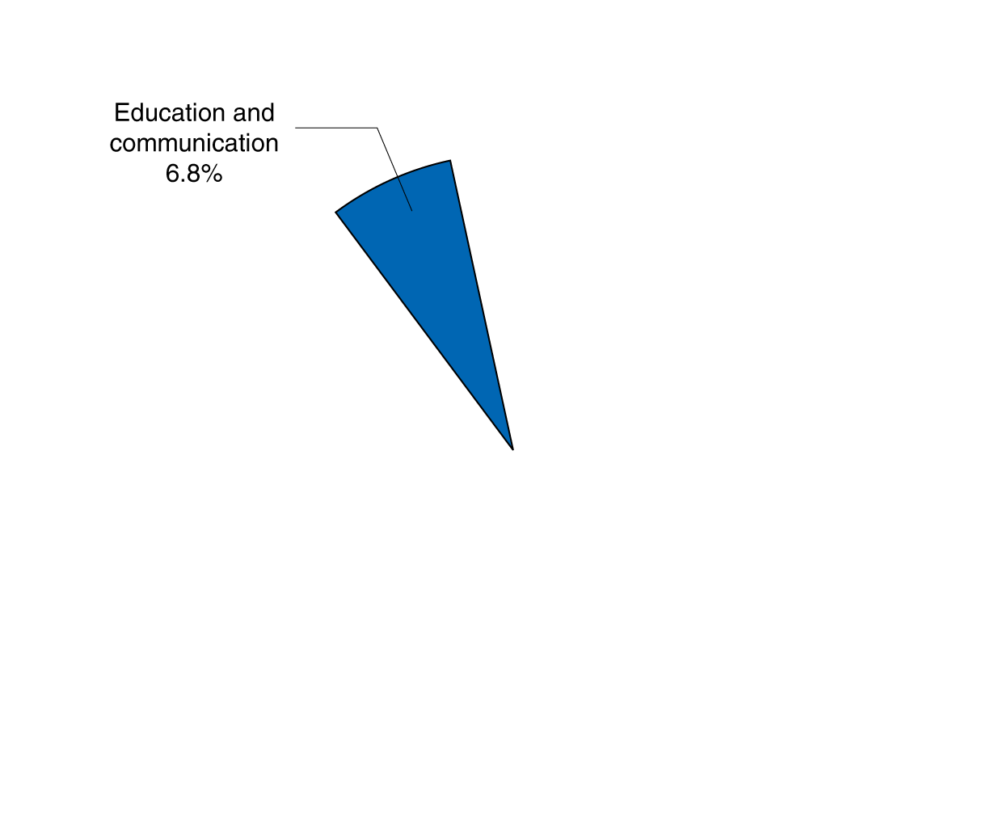
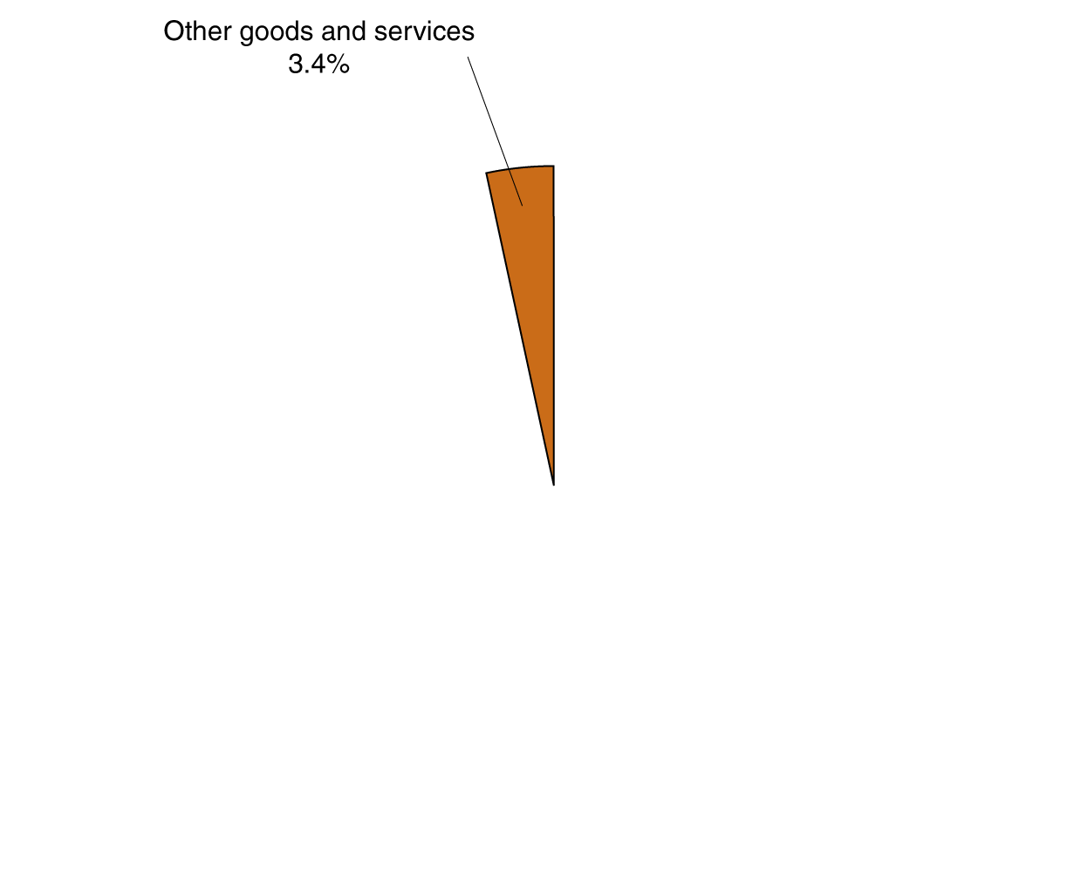
Consumer price index
The consumer price index is a measure of the average change over time in the prices a typical urban family of four pays for the goods and services they purchase.
The chart shows the composition of the basket of goods used to create the CPI. This basket of goods derives from a survey of 14,000 households by the BLS.
Figure 9.7
The CPI market basket, December 2012
Notes:
The Bureau of Labor Statistics surveys
14,000 households on their spending habits.
The results are used to construct a market
basket of goods and services purchased by
a typical urban family of four. The chart
shows these goods and services, grouped
into eight broad categories. The percentages
represent the expenditure shares of the categories
within the market basket. The categories
of housing, transportation, and food
make up about three-quarters of the market
basket.
Source: U.S. Bureau of Labor Statistics.

Slide 37
Calculating the CPI
To calculate the CPI in a given year, we need:
A basket of goods
The cost to purchase the basket of goods in a base year
The prices in the current year
The CPI in the current year is the cost to purchase the basket of goods this year, divided by the cost in the base year. By convention, we multiply this by 100, so that the CPI in the base year is 100.

Slide 38
A simple CPI calculation
 | Base Year (1999) |  |  | 2014 |  | 2015
Product | Quantity | Price | Expenditures | Price | Expenditures (on base-year quantities) | Price | Expenditures (on base-year quantities)
Eye examinations | 1 | $50.00 | $50.00 | $100.00 | $100.00 | $85.00 | $85.00
Pizzas | 20 | 10.00 | 200.00 | 15.00 | 300.00 | 14.00 | 280.00
Books | 20 | 25.00 | 500.00 | 25.00 | 500.00 | 27.50 | 550.00
TOTAL |  |  | $750.00 |  | $900.00 |  | $915.00
The table above gives the information we need to create the CPI in 2014 and 2015, using the basket of goods from 1999.
Formula | Applied to 2014 | Applied to 2015
CPI =

Slide 39
A simple CPI calculation—continued
Formula | Applied to 2014 | Applied to 2015
CPI =
Based on these data, the inflation rate from 2014 to 2015 is the percentage change in the CPI:
Since the CPI measures consumer prices, it is often referred to as the cost of living index. CPI-inflation is sometimes used to generate “fair” increases in wages for workers, and government benefits.

Slide 40
Is the CPI an accurate measure of inflation?
Some potential problems with the CPI include:
Substitution bias: Consumers may change their purchasing habits away from goods that have increased in price.
Increase in quality bias: Products like cars and computers have become more durable and better quality over time. It is hard to isolate the pure-inflation part of price increases.
New product bias: The basket of goods changes only every 10 years. There is a delay to including new goods like cell phones.
Outlet bias: Increases in purchases from discount stores like Sam’s Club and Costco or the internet are not incorporated into the CPI; it still uses full-retail price.
For these reasons, economists believe the CPI overstates true inflation by 0.5 to 1 percentage point.

Slide 41
Producer price index (PPI)
The producer price index is an average of the prices received by producers of goods and services at all stages of the production process.
It is conceptually similar to the CPI, in that it uses a basket of goods, but the goods are those used by producers.
The PPI can give early warning of future movements in consumer prices.

Slide 42
Using Price Indexes to Adjust for the Effects of Inflation
9.5
Use price indexes to adjust for the effects of inflation.

Slide 43
Using price indexes to adjust prices
Suppose your mother received a salary of $25,000 in 1987. This would have bought much more than a salary of $25,000 in 2012.
We can use the CPI to estimate the purchasing power of that $25,000 in 2012 dollars:
So $25,000 in 1987 would have bought about as much as $50,000 in 2012.

Slide 44
Nominal and real values
The current standard base “year” for the CPI is an average of 1982-1984 prices.
Values like wages in current-year dollars are called nominal variables. When we adjust them for inflation, by dividing by the current year’s price index and multiplying by 100, we convert them to real variables.
Example: Caterpillar employees signed a contract freezing wages until 2018. How much less will their wages be worth then?
Year | Nominal Average Hourly Earnings | CPI (1982–1984 = 100) | Real Average Hourly Earnings (1982–1984 dollars)
2013 | $27.00 | 233 | $11.59
2018 | 27.00 | 260 (est) | 10.38
If the CPI rises to 260, then Caterpillar employees will receive a real wage decrease of:

Slide 45
Nominal Interest Rates versus Real Interest Rates
9.6
Distinguish between the nominal interest rate and the real interest rate.

Slide 46
Inflation and interest rates
When you lend money to someone, they typically agree to pay you back with interest. If the interest rate is 6%, for example, then a $1,000 loan paid back in a year will be paid back with $1,060.
This 6% is the nominal interest rate: the stated interest rate on a loan. But in that year’s time, prices will have risen; so the $1,060 next year is not worth the same as $1,060 this year.
We can adjust for inflation by calculating the real interest rate, equal to the nominal interest rate minus the inflation rate. (Note: this is an approximation, but it is quite accurate for low interest and inflation rates.)
If prices rise by 2% from this year to next, then your real interest rate on the loan is only 4%. This more accurately reflects the cost of borrowing and lending money.

Slide 47
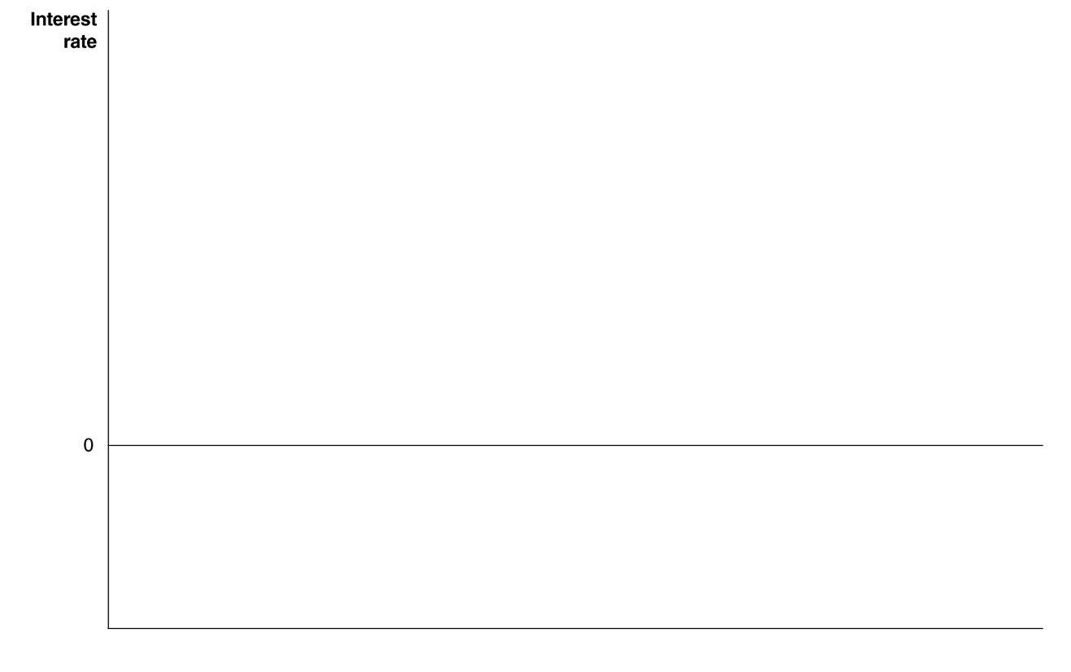

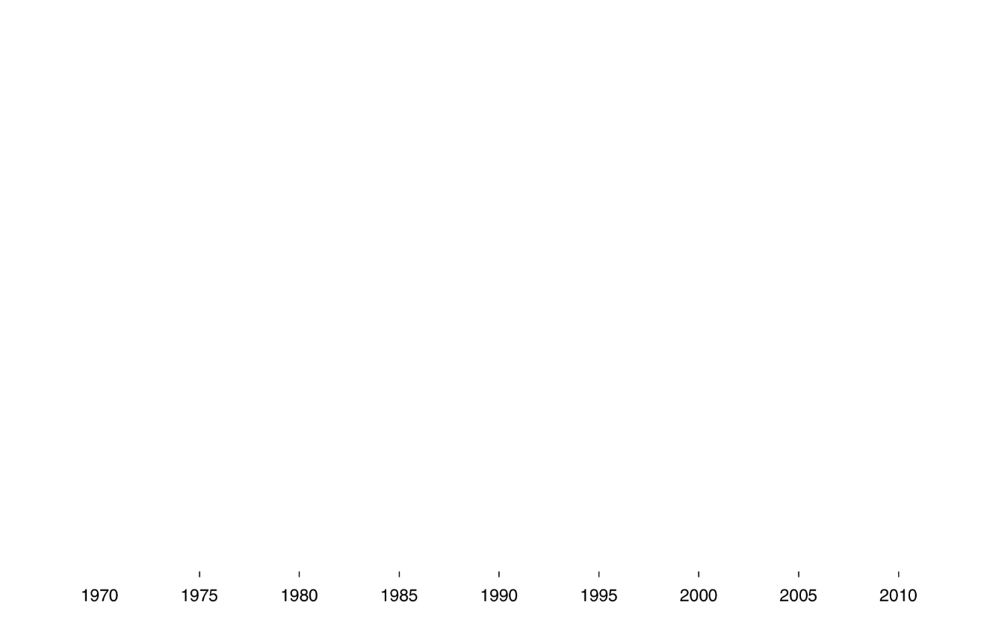
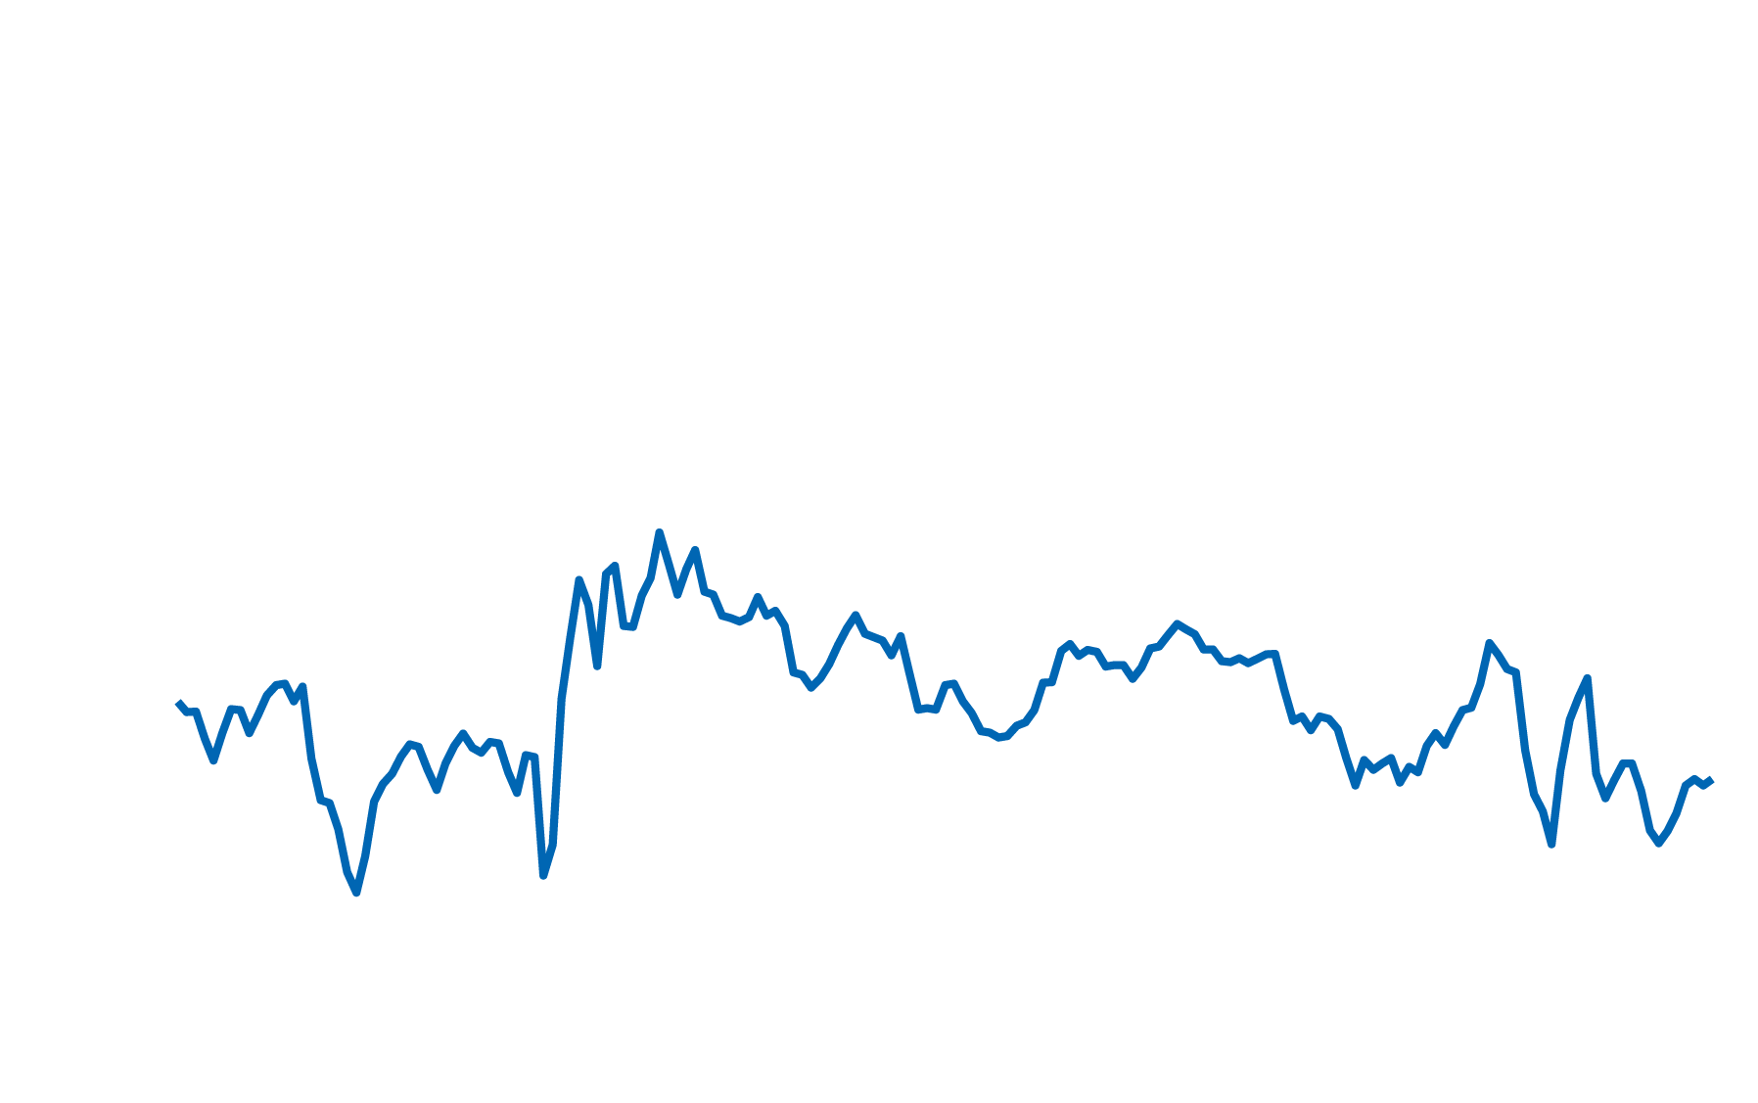
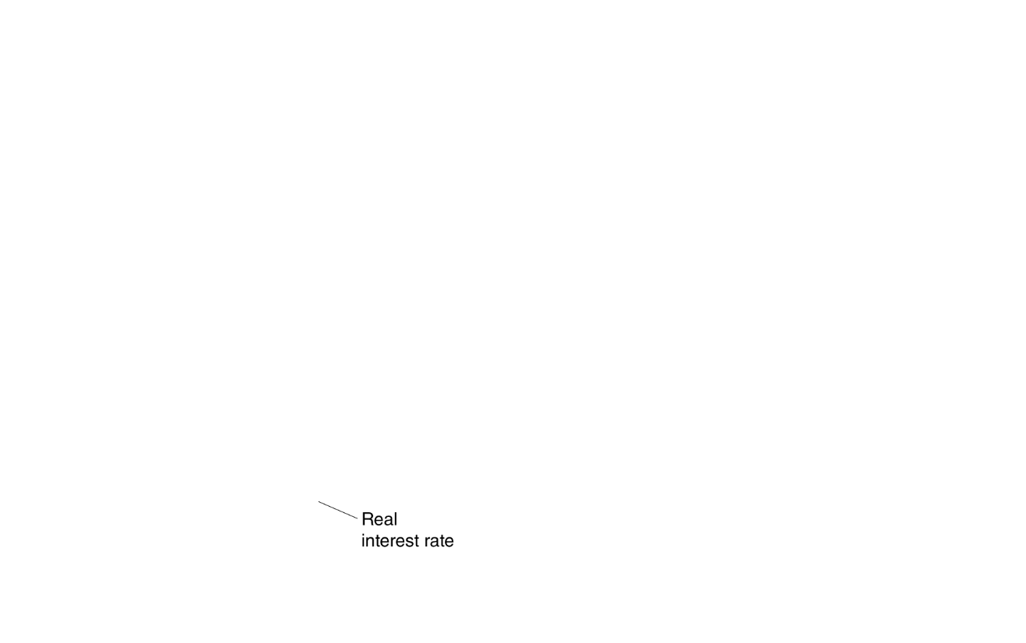


U.S. nominal and real interest rates
The chart shows the interest rate on three-month treasury-bills, a good measure of the nominal interest rate.
The real interest rate adjusts them for changes in the CPI.
Figure 9.8
Nominal and real interest rates, 1970-2013
Notice that in 2009, the real interest rate was above the nominal interest rate. This was because the change in the CPI was negative then, indicating a rare deflation, or decrease in the price level.
Notes:
The real interest rate is equal to the nominal interest rate minus the inflation rate.
The real interest rate provides a better measure of the true cost of borrowing and
the true return to lending than does the nominal interest rate. The nominal interest
rate in the figure is the interest rate on three-month U.S. Treasury bills. The
inflation rate is measured by the percentage change in the CPI from the same
quarter during the previous year.
Source: Federal Reserve Bank of St. Louis.

Slide 48
Does Inflation Impose Costs on the Economy?
9.7
Discuss the problems that inflation causes.

Slide 49
Is inflation a problem?
Sometimes inflation seems unimportant. After all, if all prices doubled overnight, it seems like nothing much would change: the prices of goods and services would have doubled, but so would your wage; so you could afford exactly as much as before.
But there are some less obvious problems with inflation. For example, inflation affects the distribution of income and wealth
It is unlikely that everyone’s wages would increase at the same rate. Many people have long-term contracts specifying their wage in nominal terms, for example.
Also, nominal assets like cash decrease in value when there is significant inflation. If you hold much of your wealth in cash, then inflation causes a significant decrease in real wealth for you.

Slide 50
Problems with anticipated inflation
Even if inflation is anticipated, it still causes problems:
People and firms have increased real costs of holding cash.
Firms have menu costs: the cost to firms of changing prices. Frequently changing prices cause are inconvenient for firms (and consumers too!) to deal with.
Investors are taxed on nominal returns, rather than real returns; so this can increase the tax due.

Slide 51
Problems with unanticipated inflation
When people cannot predict the rate of inflation, they find it hard to make good borrowing and lending decisions.
For example, in 1980 banks were charging 18% or more on home loans because the rate of inflation was very high. People who bought homes were locked into high rates even when inflation subsided.
On the other hand, if banks lend money at a low rate and then high inflation takes place, the real interest rate they receive may be zero or negative; thus the risk of inflation makes banks wary of lending.
Unpredictable inflation makes borrowing and lending risky.

Slide 52





What’s so bad about falling prices?
Deflation is much more dangerous for an economy than inflation.
Why? Suppose you are considering buying a car. You know the car will be cheaper next year, so you delay purchasing. But if everyone does the same, then many purchases are postponed, firms stop producing, people become unemployed, etc.
This can create a dangerous downward-spiral, delaying economic recovery. Economists believe this occurred after the Great Depression of the 1930s, and also in Japan in the 1990s.
There were concerns that significant periods of deflation might have followed the recession of 2007-2009. but fortunately that did not occur.

Slide 53
Common misconceptions to avoid
Many economic indicators like the unemployment rate are only created from sample data, so they are not exact measures of economic well-being.
The BLS does not estimate separately the causes of unemployment; but these are still useful to understand.
The price level compares prices in a given year to those in a base year; inflation represents changes in price levels. Do not confuse the two.

